Slide 1

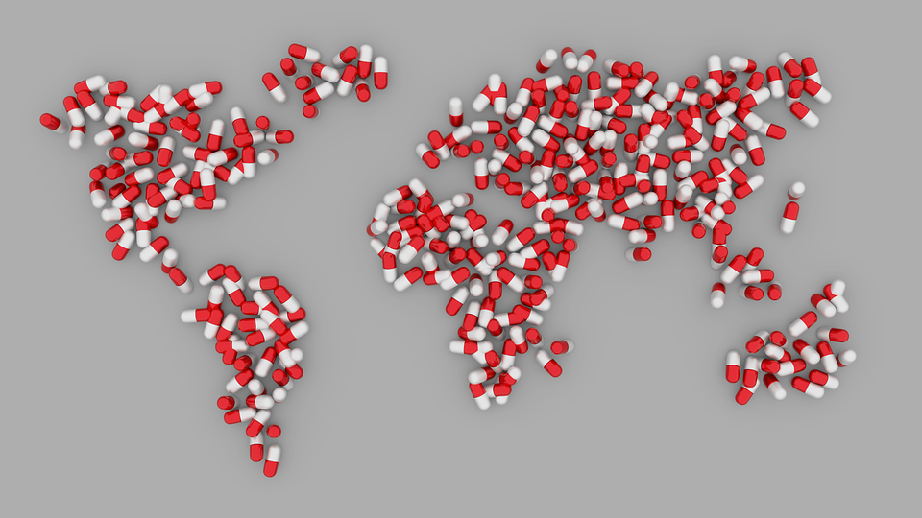


Stewardship antimicrobica e ruolo dell’infermiere: lo scenario internazionale
Evelina Tacconelli
ID-CARE (Infectious Diseases Center for trAnslational Research)
University of Verona, Italy
DZIF Research Clinical Unit - Translational Unit on Healthcare-associated and Antibiotic-resistant Bacterial Infections
Tübingen University, Germany

Slide 2

Declaration of interest (DOI)
2016-2021
  Innovative Medicine Inititiative (IMI)
  Joint Programming Initiatives on Antimicrobial Resistance (JPIAMR)
  Horizon 2020
  WHO
  ESCMID
  German Center Infectious Diseases Research (DZIF)
  GARDP

Slide 3
Road map
1
Aggiornamento resistenza agli antibiotici
Evidenze: stewardship antibiotici e resistenza
2
3
Evidenze: infermiere e stewardship
4
Ricerca: stewardship in Europa
5
Riflessioni finali

Slide 4
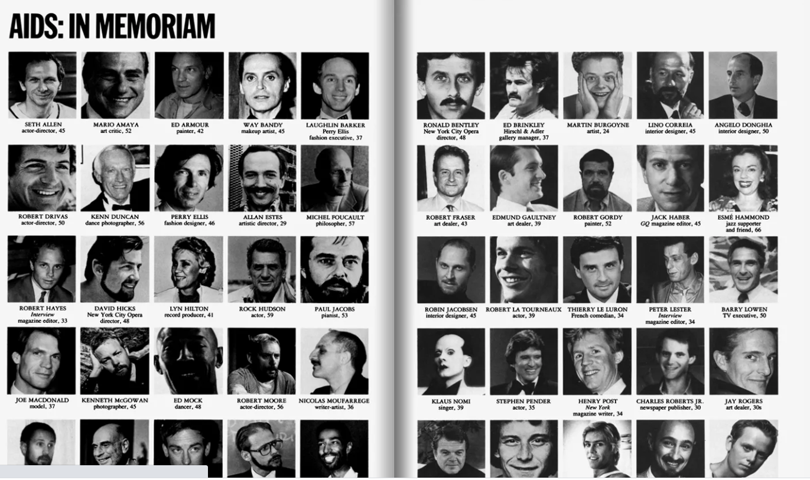
1994
1990

Slide 5


Slide 6

“There are only two infectious disease situations that can be considered inevitable, serious pandemic threats: influenza and antimicrobial resistance”
Mark Olshaker & Michael T. Osterholm, 2017

Slide 7
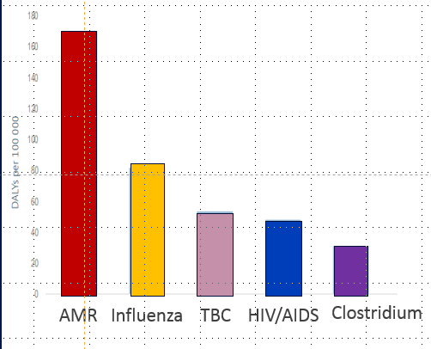
Impatto sugli anni di vita corretti per la disabilita´
AMR: antimicrobial resistance
Infuenza
TBC
HIV/AIDS
ECDC (2018) - Cassini, LID 2019; Euro Surveill. 2018

Slide 8
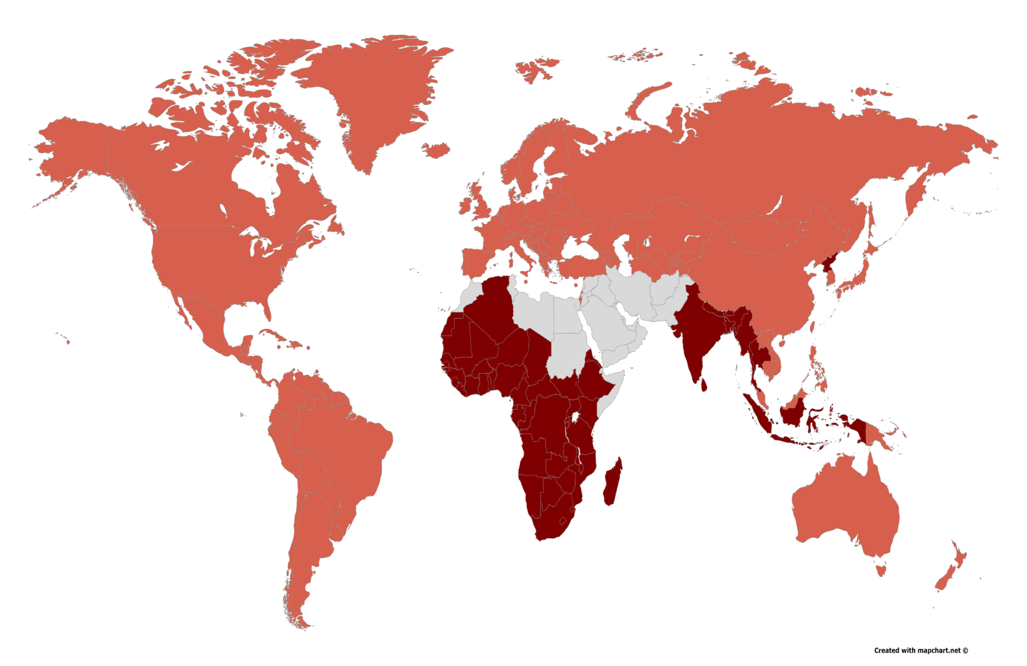


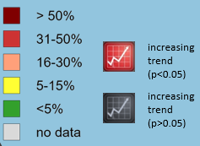

Carbapenem resistant Acinetobacter baumannii
Prevalence and 10 yrs trend of resistance in the 6 WHO regions
+40%
+40%
+40%
+20%
Tacconelli et al, OMS Lista dei batteri ad alta priorita´2017

Slide 9
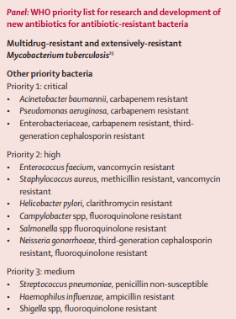
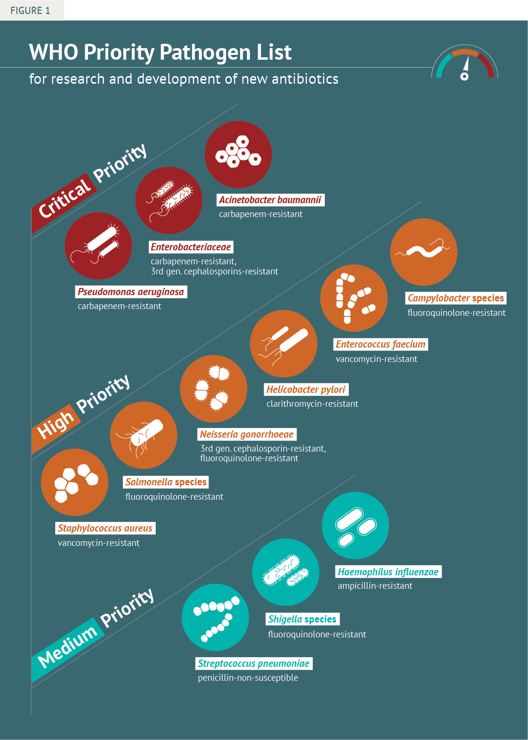
Priority for R&D of new, effective antibiotics
Tacconelli Lancet Infect Dis 2017

Slide 10
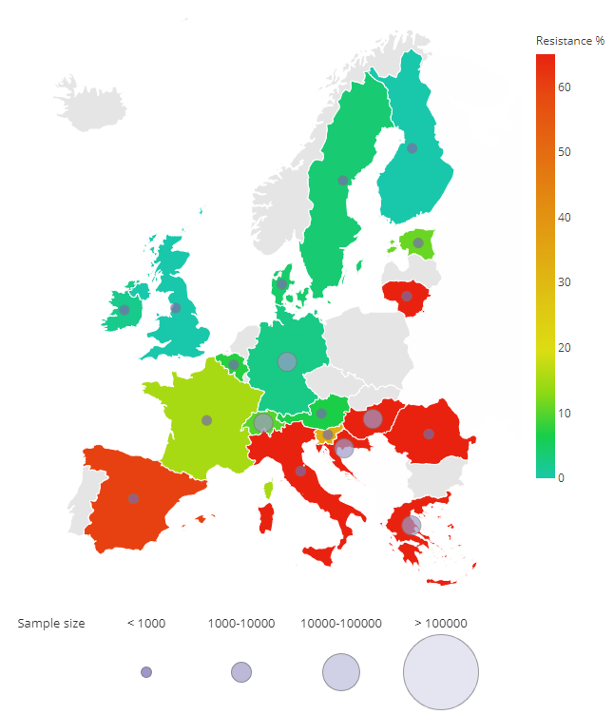
Acinetobacter resistente ai carbapenemi
Sorveglianza nazionale 2017-2019 www.epi.net-eu
E´arrivato il momento di dichiarare che in Italia qualcosa non ha funzionato correttamente e prendersi le proprie responsabilita´
La differenza nel rischio di acquisire una infezione resistente agli antibiotici è diversa nei diversi Paesi Europei. Di conseguenza il diritto all’accesso a cure uguali per tutti i cittadini Europei decade.

Slide 11
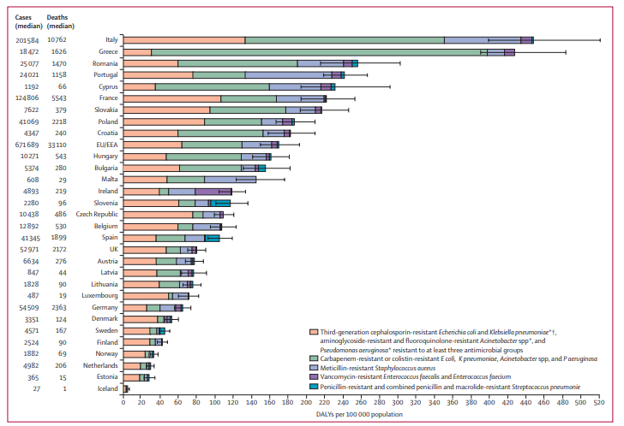
Mortalita´ stimata in Europa per infezioni da batteri resistenti agli antibiotici
Cassini, LID 2019

Slide 12
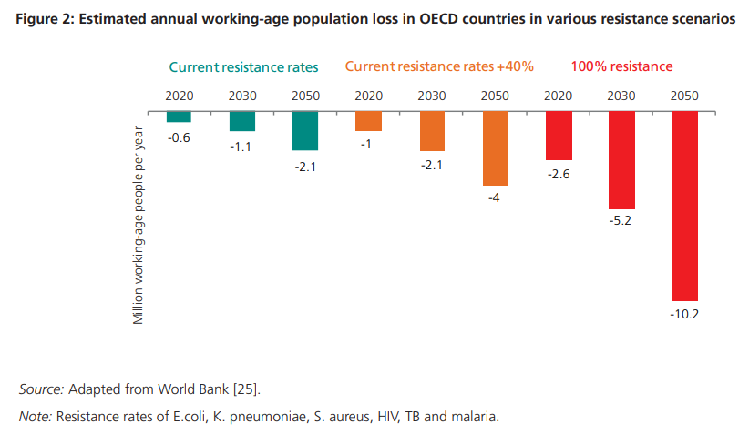
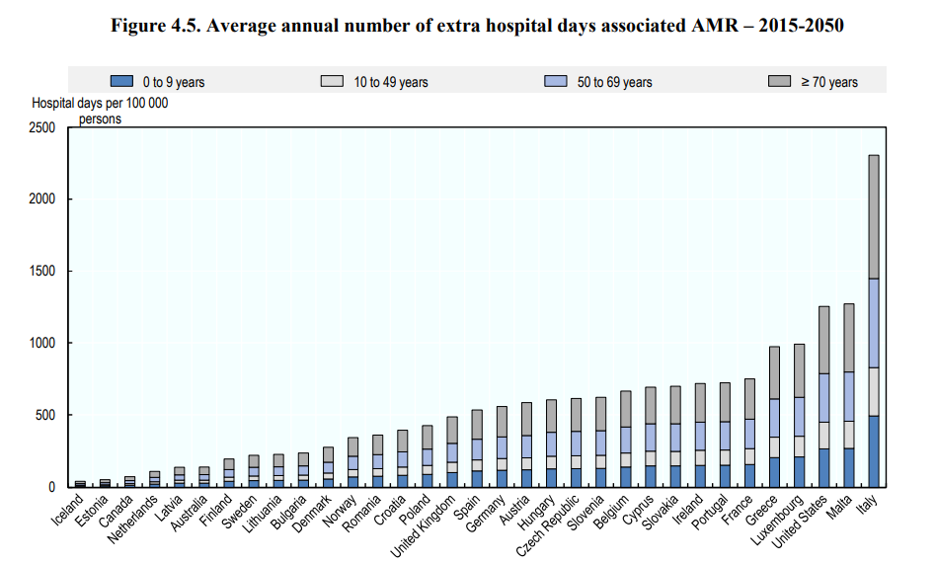
Giorni di lavoro persi a causa della resistenza agli antibiotici
Giorni extra di ospedalizzazione a causa della resistenza
OECD Report 2018

Slide 13
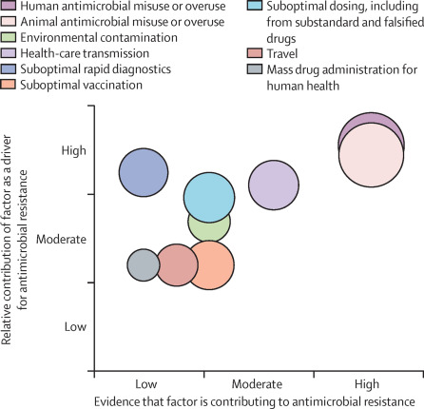
Fattori di rischio per lo sviluppo di resistenza
Uso eccessivo di antibiotici negli esseri umani
Uso eccessivo di antibiotici negli animali ed ambiente
Trasmissione intra-ospedaliera
Ridotta copertura vaccinale
Ridotta disponibilità di test diagnostici efficaci
Viaggi internazionali
Mancanza di formazione
Impatto delle case farmaceutiche (procedure ambigue)
Holmes, Lancet Infect Dis 2018
Notes:
Figure 3Role of modifiable drivers for antimicrobial resistance: a conceptual framework
An infographic to show the considered potential contribution of each factor as a driver for antimicrobial resistance. Associated relative contribution, supporting evidence, and potential population affected (diameter of bubble) was created from a two round Delphi method of contributing authors. Factors were identified from review of the national and international antimicrobial resistance literature. The Grades of Recommendation, Assessment, Development, and Evaluation (GRADE) approach was used to identify the quality of the evidence (the study with the highest GRADE estimate was cited) supporting each driver as being contributory to the rise in antimicrobial resistance (appendix).

Slide 14
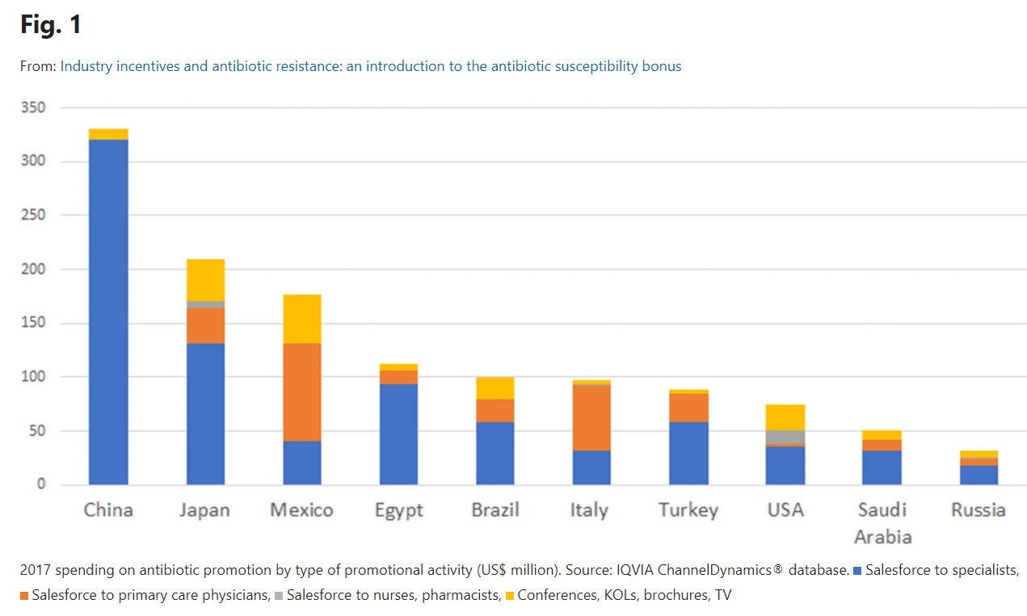
Spesa in dollari americani sulla promozione dei nuovi antibiotici delle case farmaceutiche
Morel & Hollis, Antibiotics 2020
Notes:
While there has been a significant reduction in new
antibiotics arriving on the market, there continues to be
substantial investment in the promotion of antibiotics,
suggesting that industry has a real potential role in determining
how these products are used. Using 2017 global data
from IQVIA ChannelDynamics®, we calculated the average
spending on promotion as a fraction of total revenues across
all drugs (including generics). Excluding antibiotics (ATC
code J1), the average promotional spend was 5.7% of revenues,
while antibiotics were somewhat lower at 4.2%, but
still substantial. Moreover, much of this spending is in
markets in middle-income countries, where AMR is rampant.
Figure 1 shows the type and location of spending in
leading markets.
It is helpful to understand what promotion is aimed at.
In 2017, the leading molecule for promotional spending,
according to IQVIA, was amoxicillin–clavulanic acid (9% of
total antibiotic promotion); and by far the largest share
of spending on this product (25%) was targeted at
promoting Augmentin®, the branded equivalent, although
amoxicillin–clavulanic acid has been generic in the United
States and most other countries since 2002. In effect, pharmaceutical
innovators have substantial capacity to influence
which products and how much of them are used; if not, they
would not invest so heavily in promotional activities.
The scarcity of novel antibiotic compounds in a time of increasing resistance rates has begun to ring alarm bells at the highest echelons of government. Large new financial incentives to accelerate antibiotic research and development, such as market entry rewards (MERs), are being considered. However, there is little focus on how to sustain the efficacy of new, promising antibiotics reaching the market. Currently, inappropriate use of antibiotics is commonplace, which has accelerated resistance development. In an attempt to halt this trend, antibiotic stewardship policies are being implemented in many resource-rich settings. Unfortunately, this has not yet had an impact on the amount of antibiotics being prescribed globally. One important hurdle is misalignment of incentives. While governments and health services are incentivized to promote prudent use of this common good, pharmaceutical companies are incentivized to increase volume of sales to maximize profits. This problem must be addressed or else the major efforts going into developing new antibiotics will be in vain. In this paper we outline an approach to realign the incentives of pharmaceutical companies with wider antibiotic conservation efforts by making a staged bonus a component of an MER for antibiotic developers when resistance to their drug remains low over time. This bonus could address the lack of stewardship focus in any innovation-geared incentive.

Slide 15
Perche’ prescrivere antibiotici è complicato…
Patient
Symptoms
Source of infection
Bacteria
Sensitivity pattern
Risk of development of new resistance
Drug
Penetration
Side effects
Society
Risk for future infections
Risk of relapse
Selection of resistance
Mono vs combi
Ward colonisation pressure
Risk of resistance in community
Comorbidities
Notes:
Not talking about empiric therapy

Slide 16
Stewardship della terapia antibiotica
Interventi coordinati pianificati per migliorare l’appropiatezza della terapia antibiotica e ridurre l’uso non giustificato della terapia antibiotica agendo in prima linea sulle componenti della prescrizione: scelta della classe (tipo di infezione, sede), caratteristiche del paziente (funzionalita’ epatica e renale, allergie, patologie concomitanti), dose, durata e via di somministrazione
Notes:
Antimicrobial stewardship is a collection of strategies – including policies, guidelines,
surveillance, data transparency, education, and evaluation – that collectively results in
optimization of antibiotic prescribing practices.

Slide 17
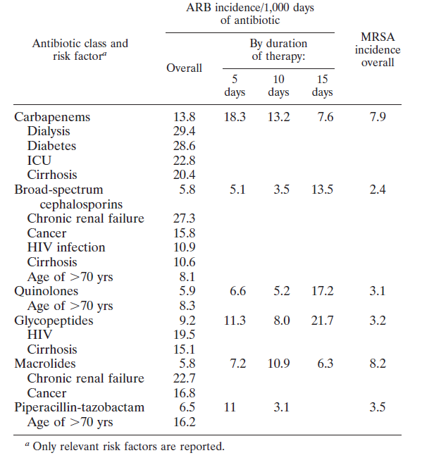
Ogni 100 pazienti diabetici che ricevono 7 giorni di carbapenemico 29 vengono colonizzati da un batterio resistente agli antibiotici
Tacconelli , AAC 2009
Notes:
Accurate assessment of risk factors for nosocomial acquisition of colonization by antibiotic-resistant bacteria
(ARB) is often confounded by scarce data on antibiotic use. A 12-month, nested, multicenter cohort study
was conducted. Target ARB were methicillin (meticillin)-resistant Staphylococcus aureus (MRSA), vancomycinresistant
enterococci (VRE), and ciprofloxacin-resistant Pseudomonas aeruginosa (CR-PA). Nares and rectal
swabs were obtained before and after starting antibiotics. Pulsed-field gel electrophoresis was done to define
genetic relatedness of the strains. Primary outcomes were (i) the mean time, in days, for acquisition of target
ARB colonization in patients previously not colonized; (ii) the rate of acquisition per 1,000 antibiotic-days
according to different classes of antibiotics; (iii) the rate of infection caused by the same bacteria as those
previously isolated in screening samples; and (iv) the risk factors for ARB acquisition. In total, 6,245 swabs
from 864 inpatients were processed. The rate of acquisition was 3%, 2%, and 1% for MRSA, VRE, and CR-PA,
respectively. The rate of acquisition of ARB per 1,000 antibiotic-days was 14 for carbapenems, 9 for glycopeptides,
and 6 for broad-spectrum cephalosporins and quinolones. The highest rates of acquisition were observed
for carbapenems in dialyzed and diabetic patients. Four risk factors were independently associated with
acquisition of target ARB: use of carbapenems, age of >70 years, hospitalization for >16 days, and human
immunodeficiency virus infection. During the 30-day follow-up, 4 among 42 patients newly colonized by ARB
(9%) suffered from an infection due to the same bacteria as those isolated in a previous screening sample.
Colonizing and infecting strains from single patients were genotypically identical. Identifying ARB colonization
early during antibiotic therapy could target a high-risk hospitalized population that may benefit from intervention
to decrease the risk of subsequent nosocomial infections.

Slide 18
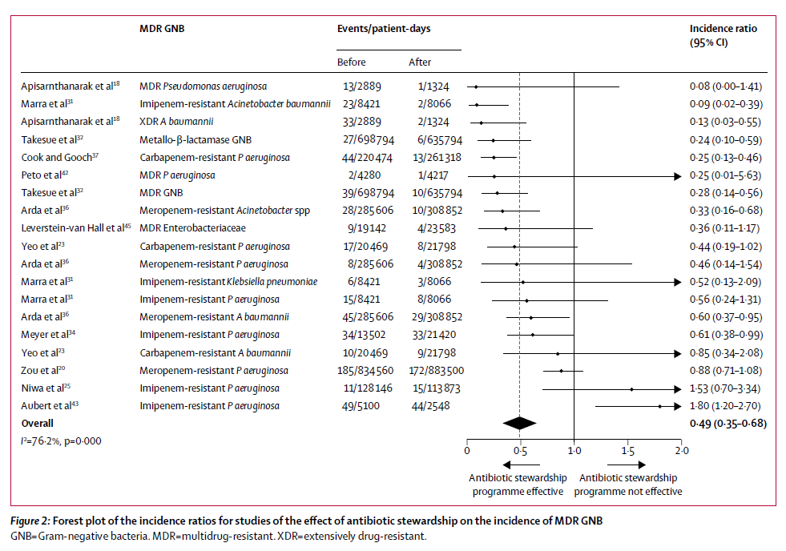
Impatto della stewardship antibiotica sulle infezioni da batteri Gram-negativi resistenti agli antibiotici : riduzione dell‘incidenza del 51%
Tacconeli, Lancet Infect Dis, 2017

Slide 19
Ruolo dell´infermiere (fattibile)
Valuta la possible sorgente di una infezione
Effettua campioni microbiologici prima dell’inizio terapia antibiotica
Somministra gli antibiotici nei tempi previsti ed al dosaggio corretto
Valuta e riporta gli eventi avversi dei farmaci inclusa la diarrea
Valuta gli isolati MDR ed applica le opportune misure di isolamento
Riporta le difficolta’ nell’assumere la terapia orale
Educa il paziente e la famiglia e lo informa ed organizza la dimissione
Facilita la comunicazione tra medici, farmacia, laboratorio, coordinatori delle dimissioni, consulenti e pazienti
Gestisce le riserve di antibiotici nel reparto e assicura la tracciabilità del loro uso
Partecipa regolarmente a corsi di formazione e riunioni in merito all’uso prudente degli antibiotici

Slide 20
Perche’ prescrivere antibiotici è complicato…
Patient
Symptoms
Source of infection
Bacteria
Sensitivity pattern
Risk of development of new resistance
Drug
Penetration
Side effects
Society
Risk for future infections
Risk of relapse
Selection of resistance
Mono vs combi
Ward colonisation pressure
Risk of resistance in community
Comorbidities
7
1
8
9
6
4
5
9
10
Notes:
Not talking about empiric therapy

Slide 21


Ruolo dell´infermiere (auspicabile)
Suggerisce ai medici prescrittori di documentare la loro rivalutazione della terapia per tutti i pazienti sotto antibiotici dopo 48-72 ore
Informa il medico prescrittore o il farmacista se si nota che un paziente ha una prescrizione antibiotica superiore ai sette giorni senza una durata specifica
Se nota membri del personale dell’ospedale o della struttura sanitaria che violano le linee guida o i protocolli, chiede spiegazioni e fornisce strumenti affinché capiscano dove stanno sbagliando
Valuta i risultati microbiologici positivi e le riporta al medico

Slide 22
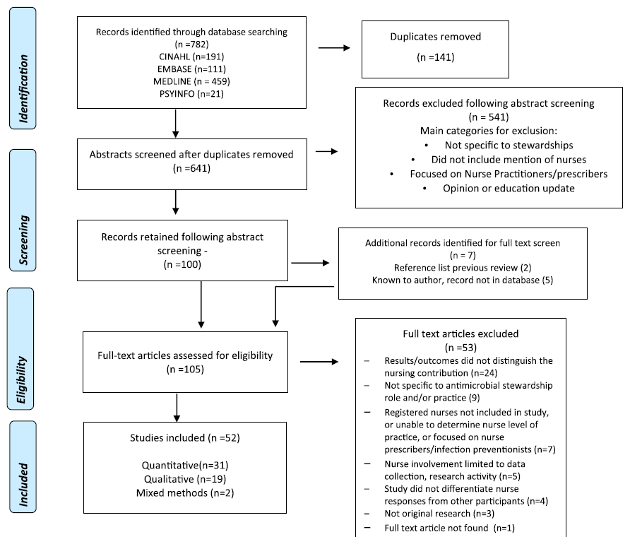
Evidenza sul ruolo dell’infermiere nella stewardship
52 studies
2008 to 2019
15 cross sectional studies
4 pre-post studies
4 quasi experimental studies
4 prospective studies
2 retrospective studies
1 historical cohort
19 qualitative
Nurse first author 18
Impact of intervention 12
9 leadership nurse
+++USA ++ Australia
Pediatric 8
Gotterson, International Journal of Nursing Studies 2021

Slide 23
Nurses’ focus on patient advocacy is evident across all settings and is a potentially important motivator of nursing involvement
Nurse influence on antimicrobial prescribing is a prominent finding, yet is poorly understood
Formal inclusion of nurses in antimicrobial stewardship is associated with improved nurse knowledge, nurse confidence, and improved clinical outcomes, but evidence on this topic remains limited
More research is needed…
Gotterson, International Journal of Nursing Studies 2021

Slide 24
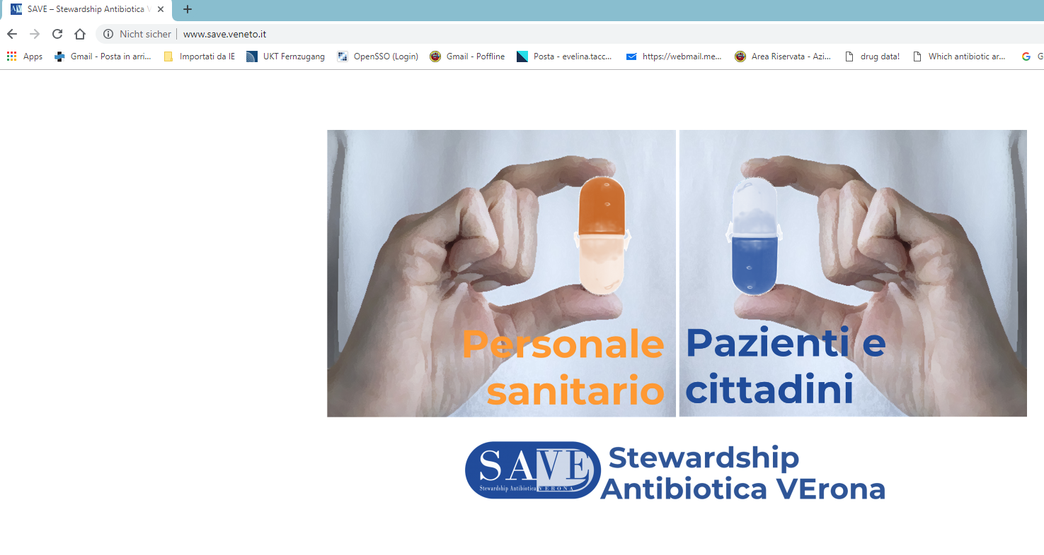
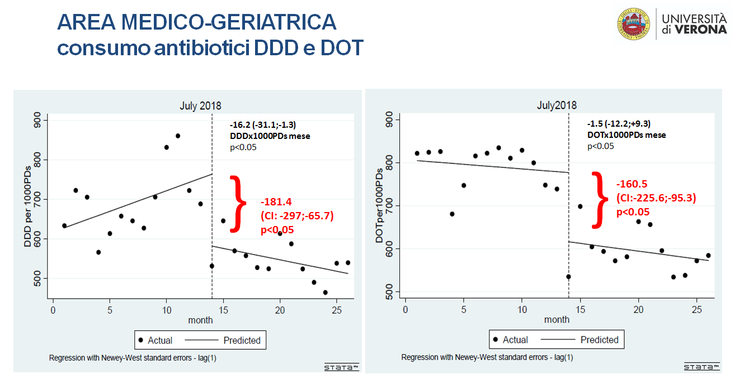
https://www.save.veneto.it
Team multidisciplinare (ID, micro, farmacia, igiene, direzione, psicologia, servizio infermieristico) con una infermiera dedicata per infection control per la presa in carico del reparto per implementare la stewardship e la stretta collaborazione del team infermieristico del reparto
2 REFERENTI MEDICI PER REPARTO
1 REFERENTE INFERMIERISTICO PER REPARTO

Slide 25
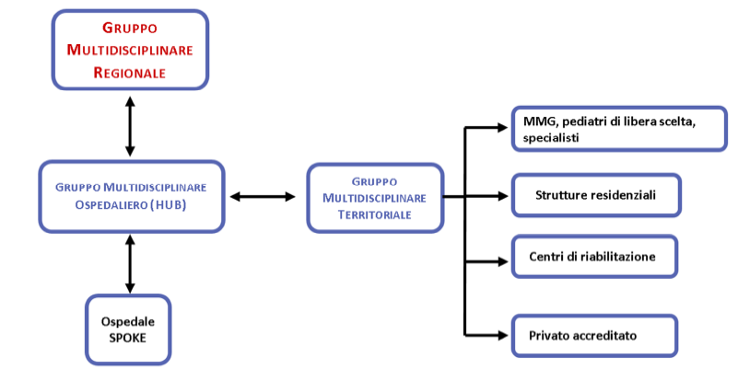
DGR Regione Veneto nr. 1402 del 01 ottobre 2019

Slide 26
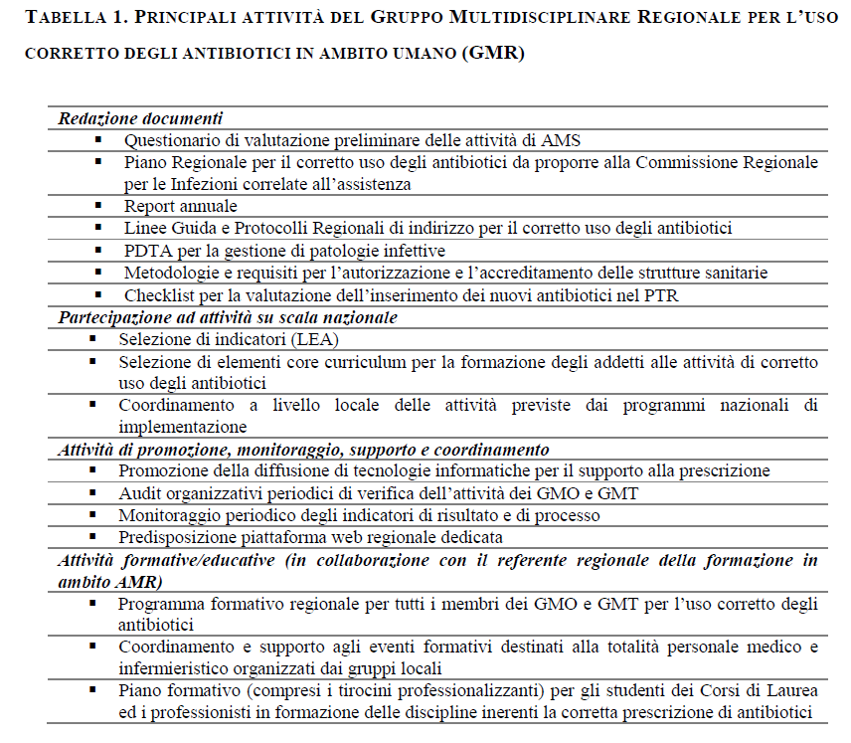
Include componente infermieristica

Slide 27
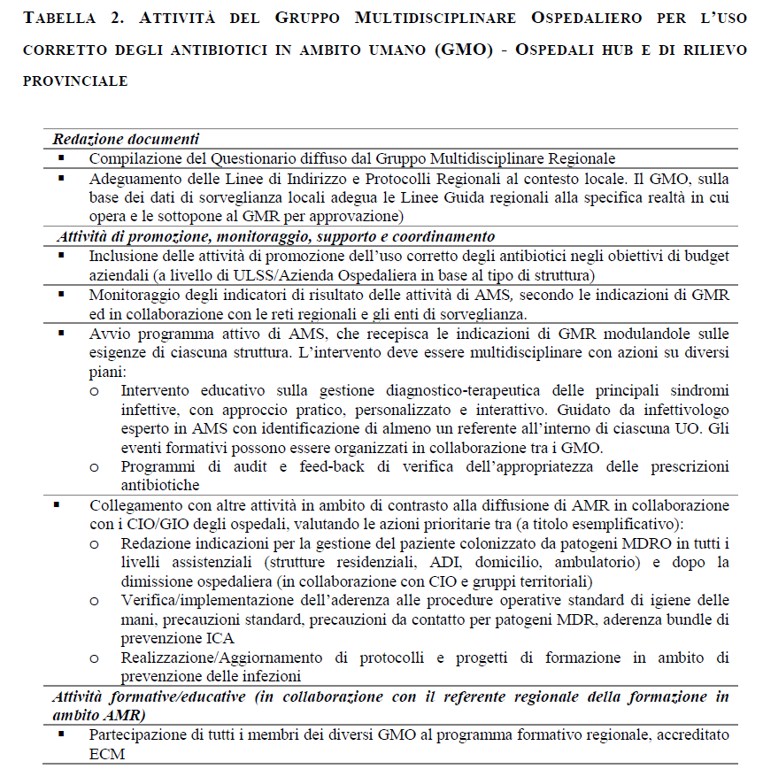
Include componente infermieristica

Slide 28
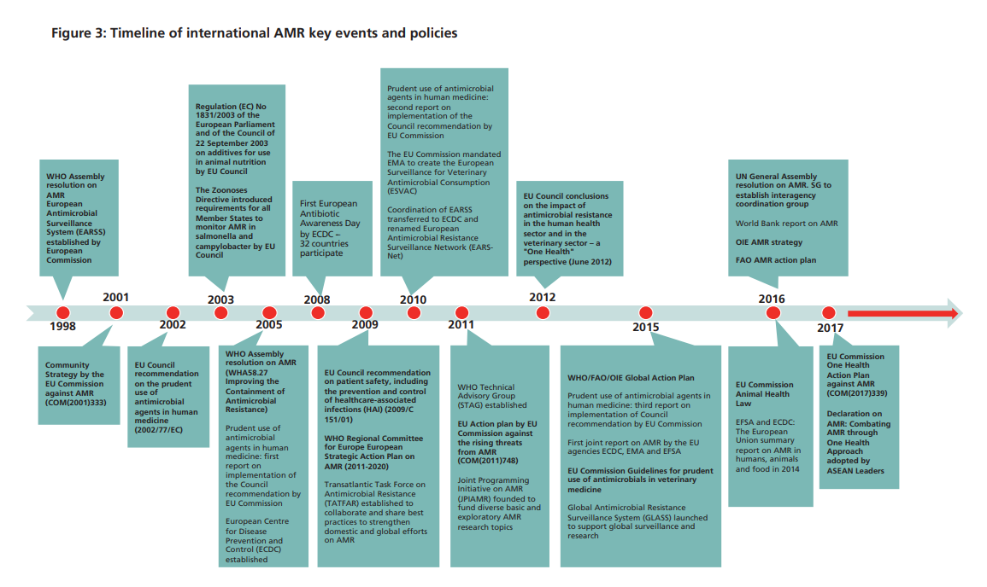

Slide 29
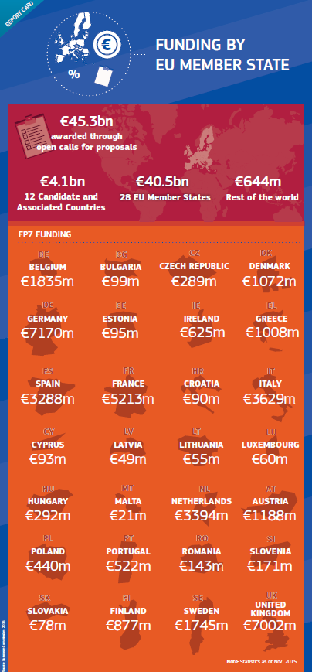
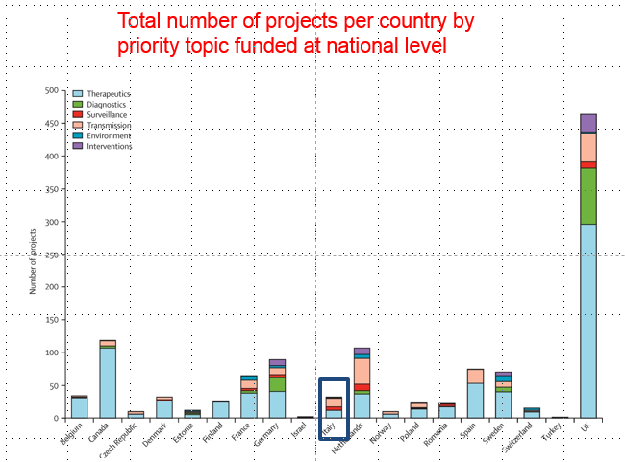

Slide 30
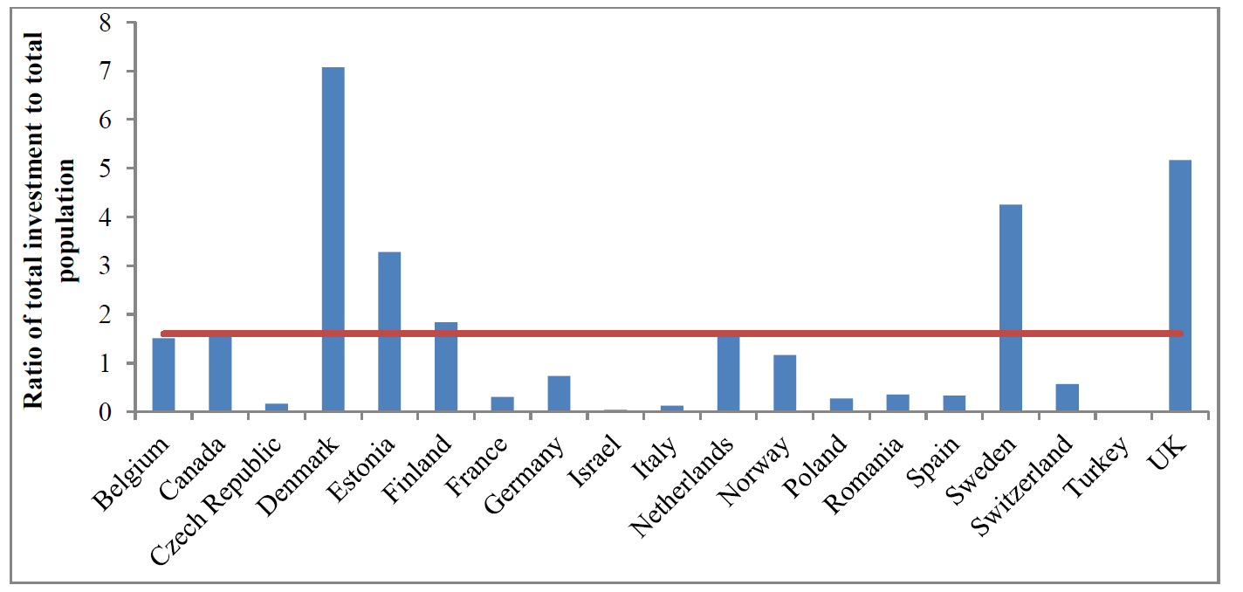
Ratio of total funding amount invested in antibacterial resistance research per country to the total national population of that country in millions
Kelly 2016 LID

Slide 31
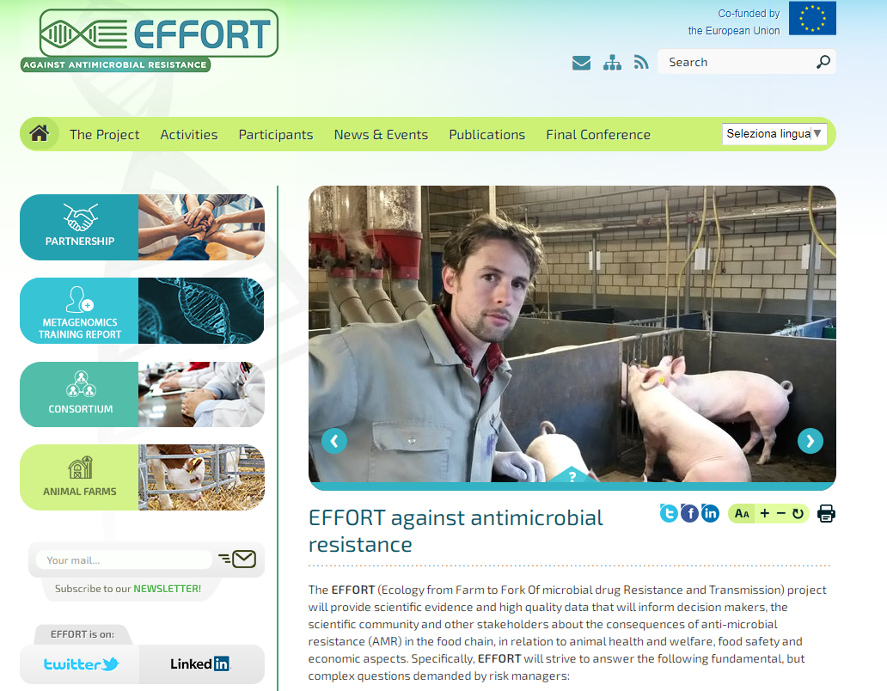
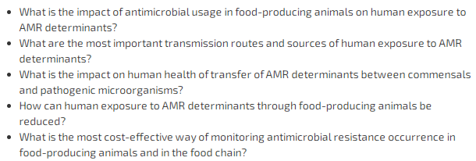

Slide 32

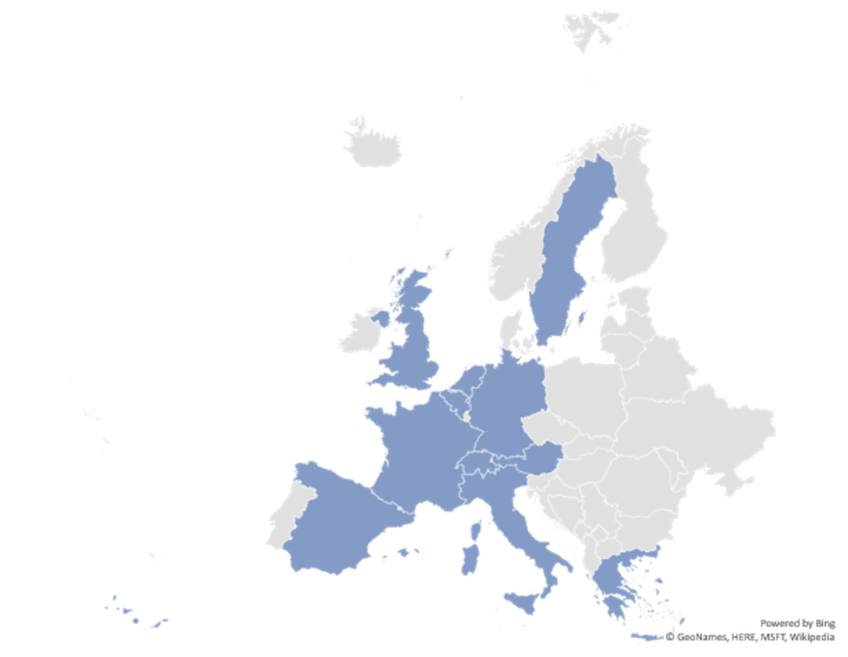
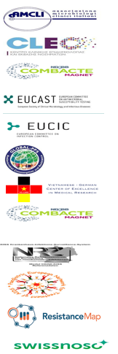
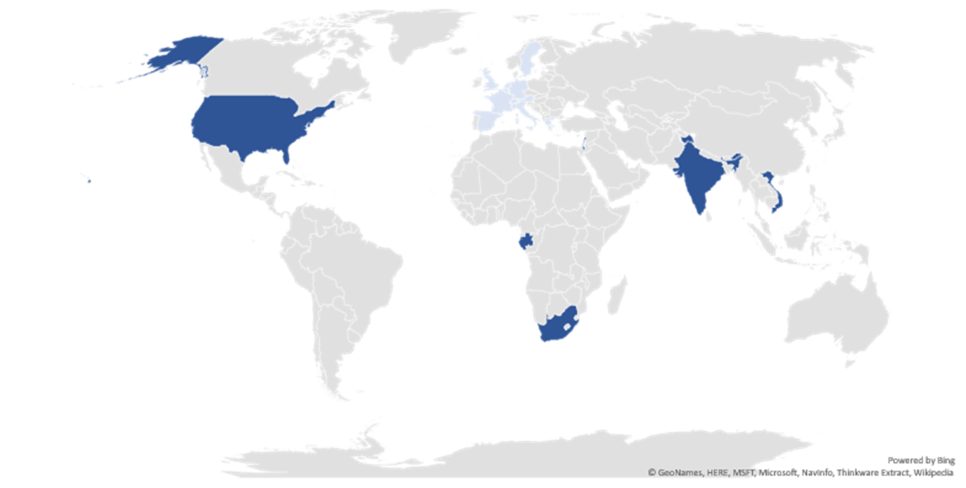


Bridging the gap between humAn and
animal suRveillance data, antibiotic poliCy,
and stewardsHip (ARCH)
https://archnet-surveillance.eu
Multidisciplinary specialists (including nurses) and networks in the field of animal and human surveillance and antibiotic usage
Major goals
  to provide new tools to strength cooperation between surveillance and stewardship teams;
  to facilitate the ATBS teams enabling appropriate assessment of the antibiotic usage data and resistance rates according to case-mix of patients and settings to develop antibiotic policy recommendations;
  to reduce the heterogeneity of microbiological and sensitivity data reporting in surveillance systems;
  to promote and harmonize reporting in animal surveillance and stewardship and to connect it with human recommendations.

Slide 33


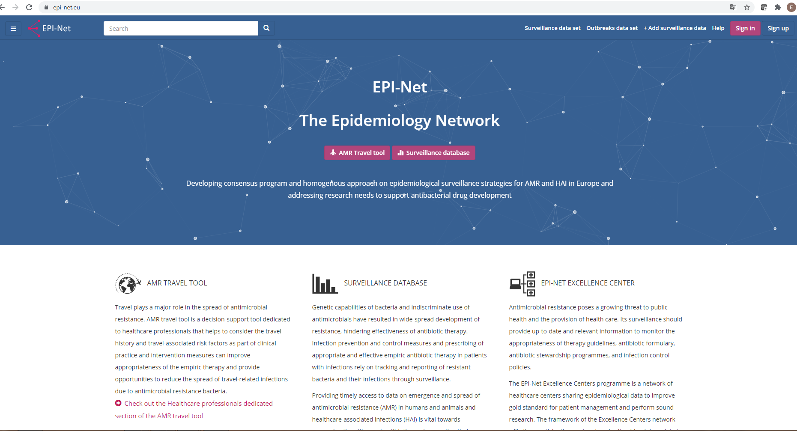
https://epi-net.eu/publications/
Checklist su come implementare la stewardship antibiotica correlando i dati microbiologici alle azioni di prevenzione e prescrizione
Ospedale
RSA
Ambulatori
Cliniche veterinarie
JAC 2020 Dec 6;75(Suppl 2)
Downloadable checklists
Tacconelli, Lancet Infect Dis 2018

Slide 34
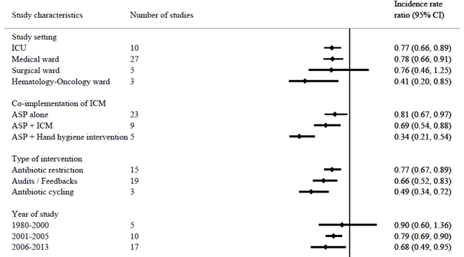
L’effetto della stewardship antibiotica e’ maggiore nei reparti dove l’aderenza al lavaggio delle mani è piu’ alto
Tacconelli, Lancet Infection Diseases 2017
Tacconeli, Lancet Infect Dis, 2017

Slide 35
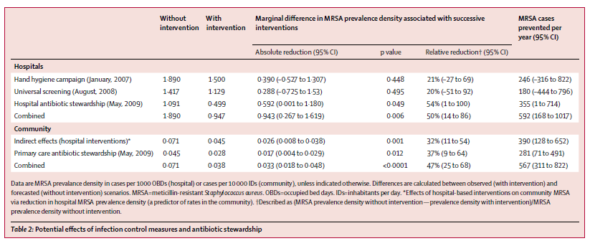
Uso degli antibiotici ridotto del 47% in ospedale e 27% in comunita´
Prevalenza di MRSA ridotta con l´introduzione della stewardship del 54% in ospedale e 37% in comunita´
Lawes, LID 2015

Slide 36

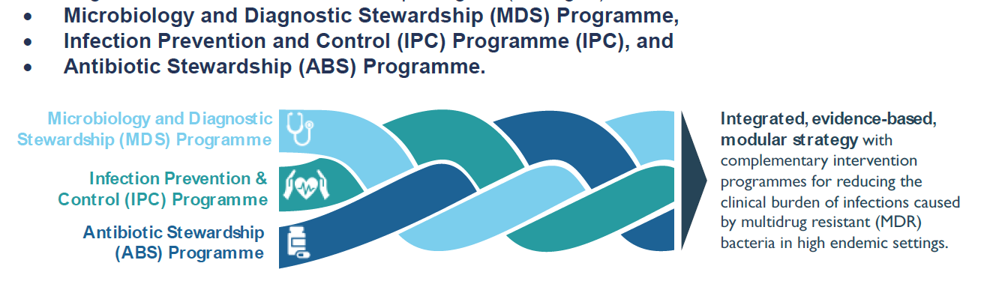
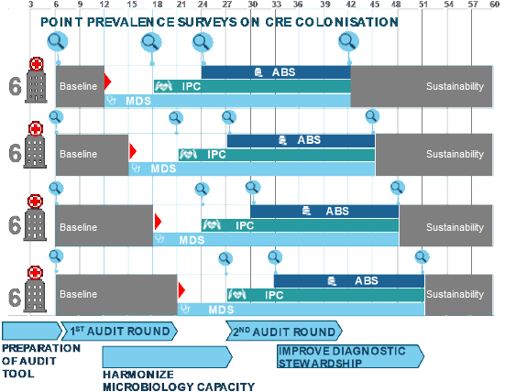
Un infermiere dedicato in ogni centro partecipante
Obiettivo primario
Ridurre incidenza delle infezioni ospedaliere da CRE, CRPE, and CRAB
Notes:
Fig 5 on the GA named «Schematic depiction of the MDS programme»; modified blurred boxes.

Slide 37
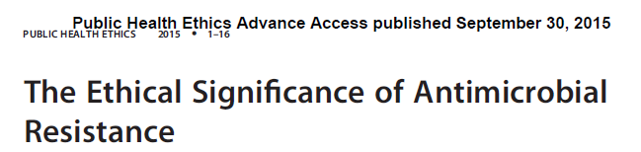
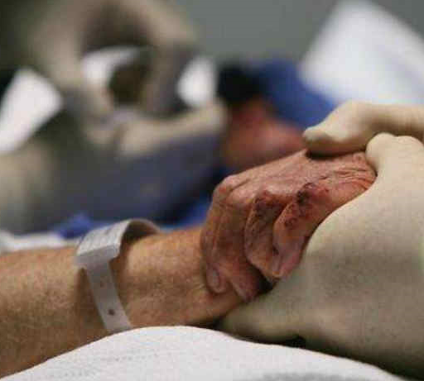
Littmann, Public Health Ethics
AMR is a distinct ethical issue
Successful responses to the problem of AMR will not only be a scientific or medical undertaking, it must also be an ethical undertaking
Every level of an AMR response (improving surveillance and reporting, reducing ATB usage, ..) strategy will inevitably involve making decisions with ethical implications
Promoting research and innovation into different preventative, diagnostic and therapeutic interventions will require us to make funding and allocation decisions that prioritise AMR over other important projects and policies

Slide 38
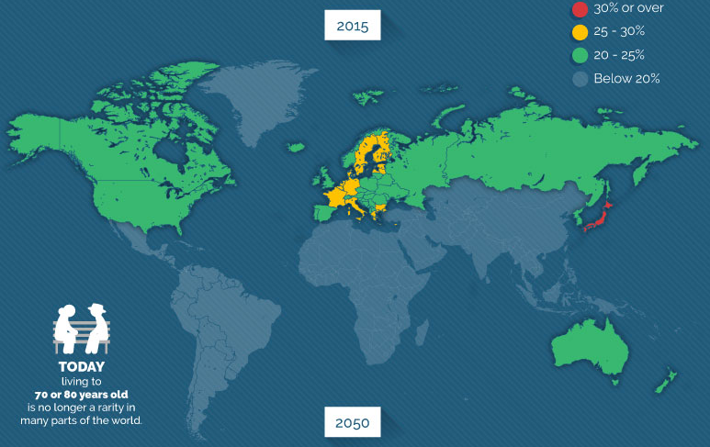
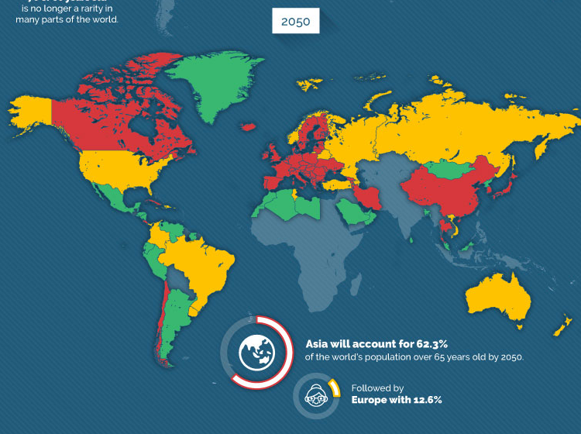

Slide 39
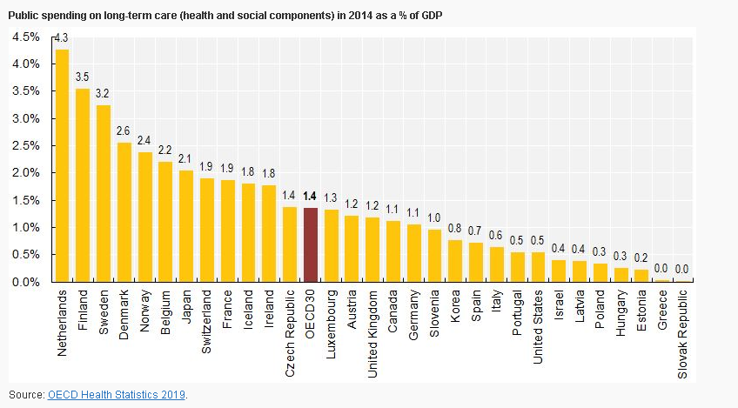

Slide 40
Riflessioni conclusive
Ridurre le infezioni ospedaliere e comunitarie da germi resistenti agli antibiotici è un dovere etico di tutti
La prescrizione corretta dell´antibiotico e´ un diritto del paziente ed un dovere dell´operatore sanitario
Per ridurre l’incremento sostanziale della resistenza ed il conseguente utilizzo di molecole di «riserva» la politica di stewardship antibiotica italiana necessita di una rivisitazione profonda
Il personale infermieristico riveste un ruolo sostanziale in un programma di stewardship antibiotica
La strategia deve essere modulata in stretta collaborazione tra tutte le diverse componenti dell’atto prescrittivo
E‘ necessario sviluppare momenti educazionali indipendenti e comuni tra medici ed infermieri e corsi di studio dedicati nel corso di Infermieristica
Modelli di stewardship senza un coinvolgimento corretto della componente infermieristica e della prevenzione delle infezioni sono destinati a fallire
Una delle piu’ grandi limitazioni per una corretta implementazione della stewardship in Italia rimane l’assenza di «reti» e «team» dedicati a livello nazionale

Slide 41
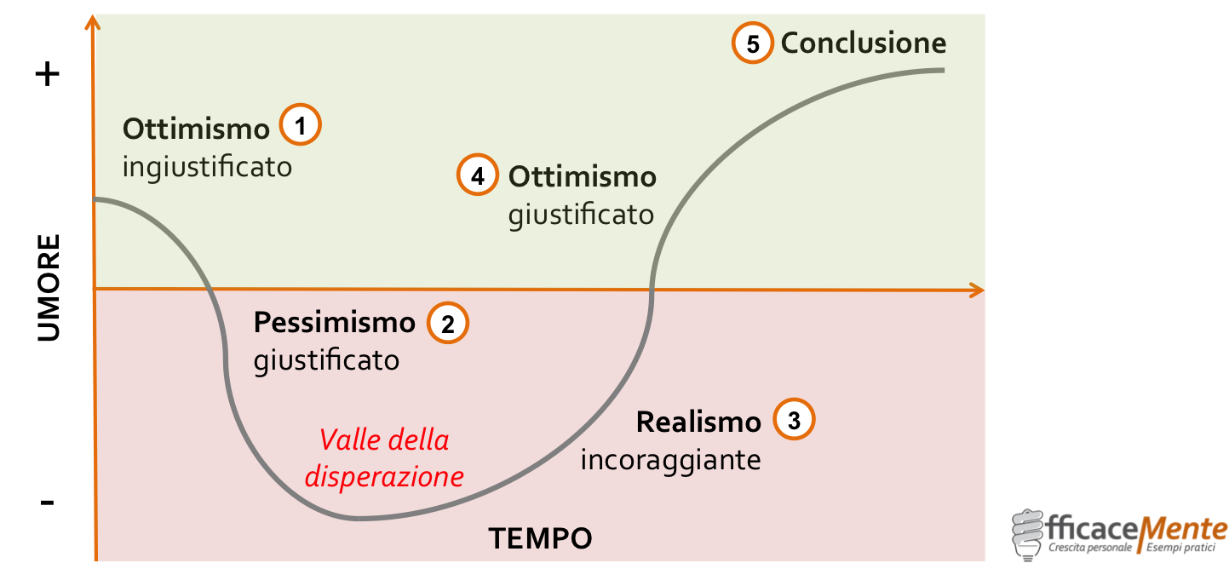
Mai scoraggiarsi
Le 5 Fasi del cambiamento….

Slide 42

Cosa serve a noi per vincere questa battaglia?
Orgoglio
Conoscenza
Forza di volontà
Umiltà
Onestà

Slide 43


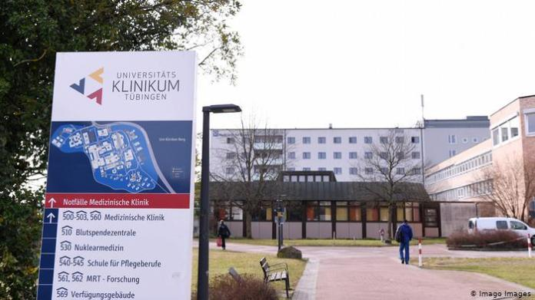
Numerose posizioni disponibili per ricerca per medici ed infermieri
@EveTacconelli
Evelina.Tacconeli@univr.it
Evelina.Tacconelli@med.uni-tuebingen.de
Buon lavoro!
https://www.id-care.net/

