Slide 1
Adverse health impact of COVID-19 on health workers
ANIPIO – Evento celebrativo “i nostri primi 30 anni con voi e per voi”
Alessandro Cassini, AMR Control and Strategies Unit
World Health Organization
2 ottobre 2021

Slide 2
Nessun conflitto d’interesse da dichiarare
Ringraziamenti
Maya Allan
Benedetta Allegranzi
April Baller
Isabelle Bergeri
Mathieu Boniol
Michele Cecchini
Roger Chou
Giorgio Cometto
Ivan Ivanov
Aiysha Malik
Ece Özçelik
Katrin Seeher
Alice Simniceanu
Amani Siyam
Mo Yin

Slide 3






















Transmission patterns of health workers
Community
Health workforce
COVID patients
Non COVID patients
Community transmission is a driver of transmission seen in health care facilities
https://www.who.int/emergencies/diseases/novel-coronavirus-2019/technical-guidance-publications

Slide 4
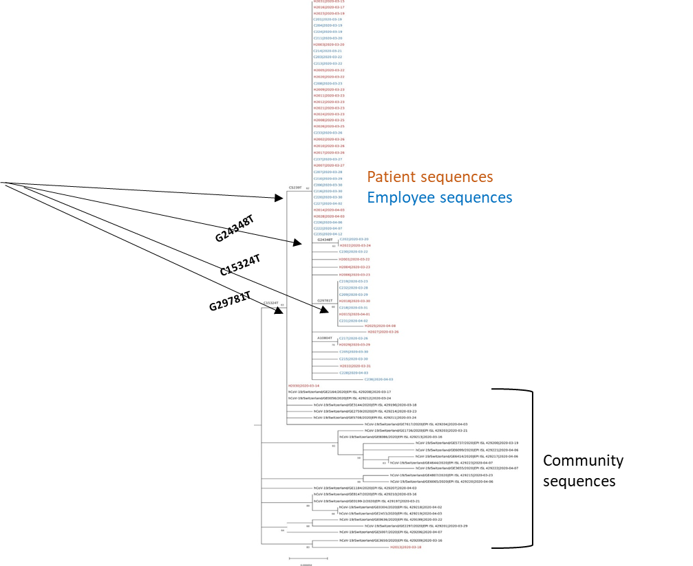
Definitions of healthcare-associated (HCA) SARS-CoV-2 infections among HWs
Thanks to N. Zhu and A. Holmes
No study has been published for HOCI surveillance or case definition specifically for HWs
2 studies* suggested criteria to be considered to identify nosocomial cases in HWs:
    SARS-CoV-2 positive test results;
    Had no positive tests in the community in the past 14 days;
    Had no known contact with confirmed cases outside healthcare facilities in the past 14 days;
    Had worked for healthcare facilities where two or more patients of healthcare-associated infections were reported in the past 14 days;
    Clear link with other healthcare-associated infections based on genomic data
*Rivett et al. https://pubmed.ncbi.nlm.nih.gov/32392129/ ;
Lai et al. https://pubmed.ncbi.nlm.nih.gov/32437575/

Slide 5
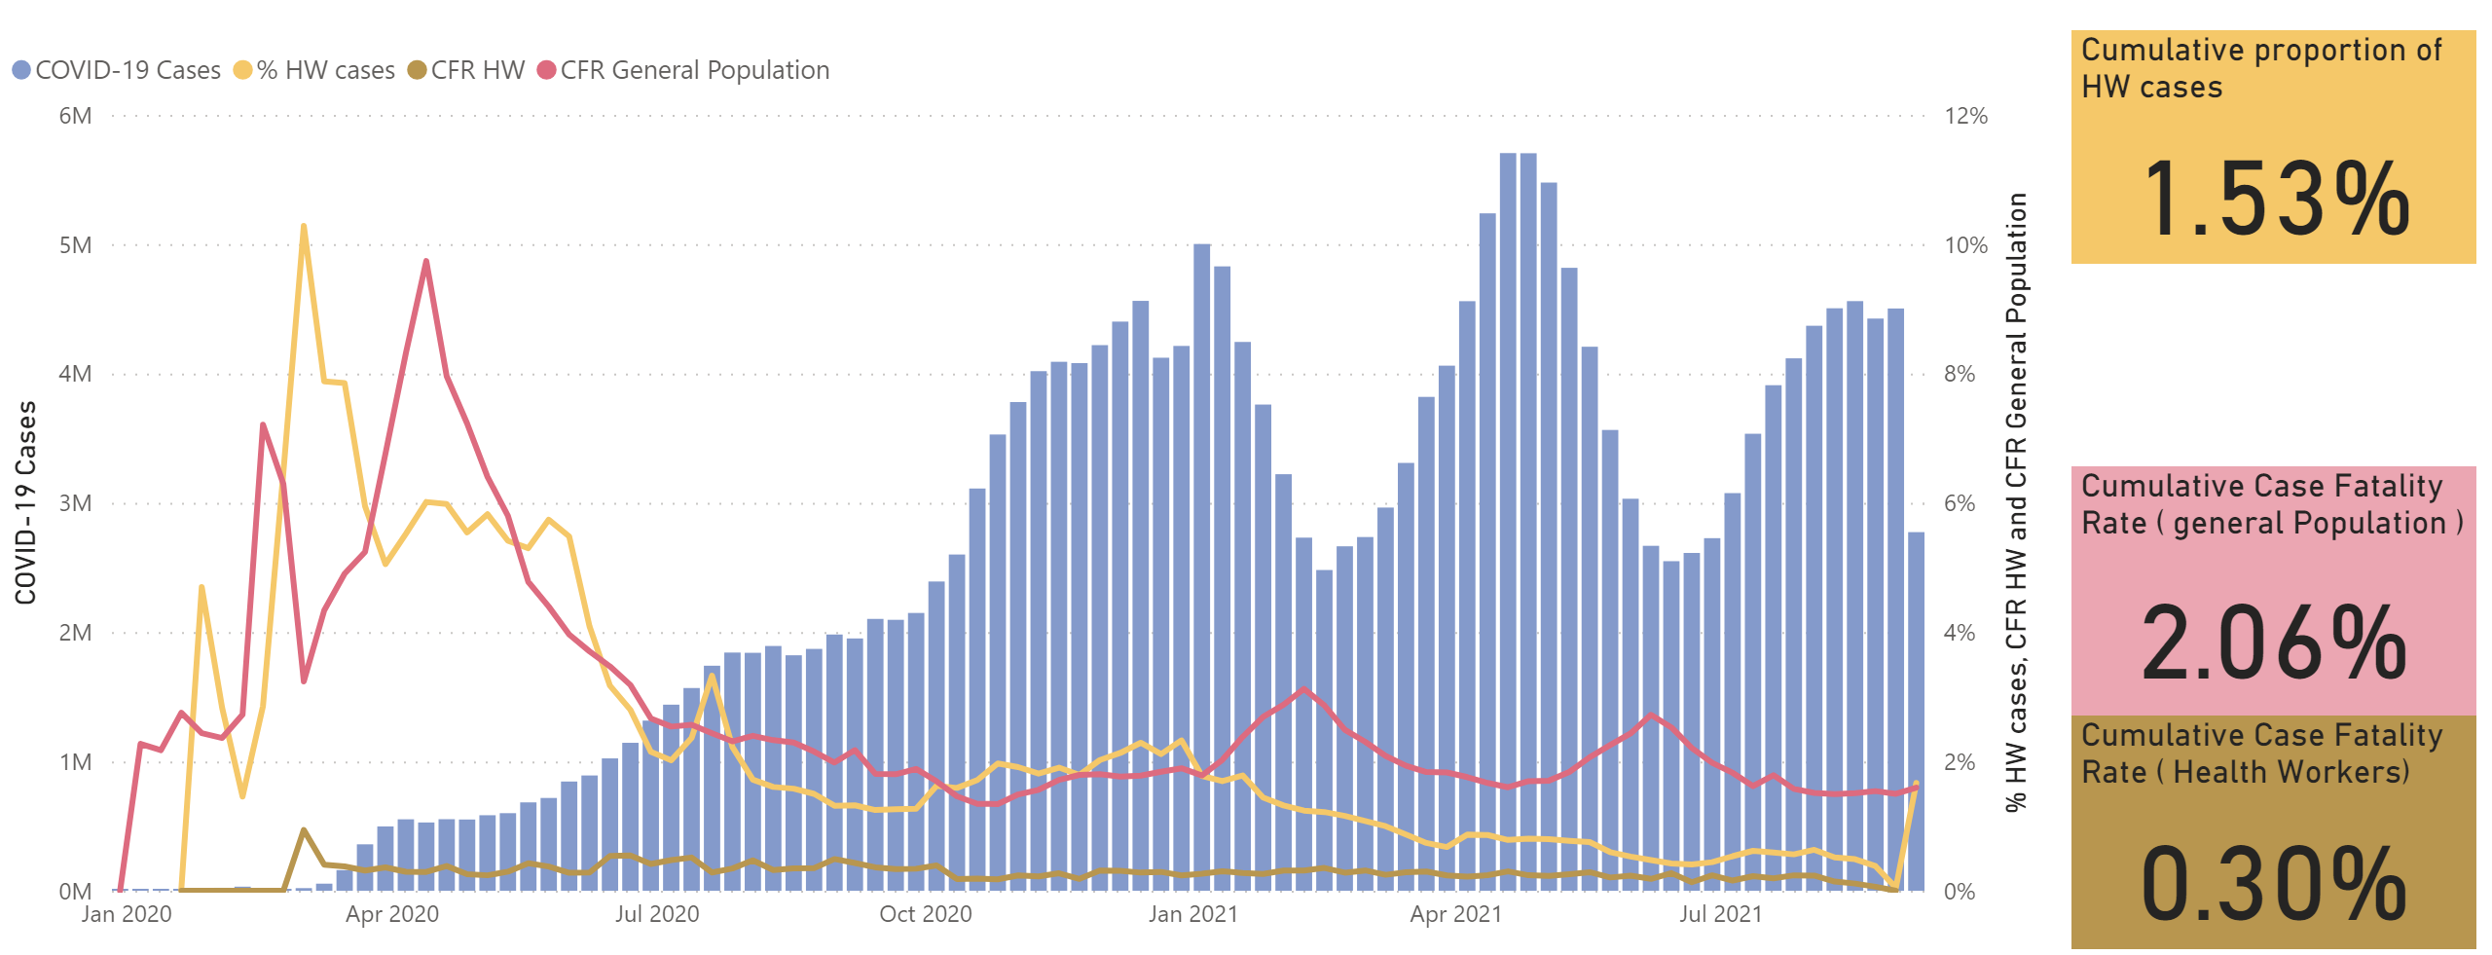
HW Trends
Global COVID-19 surveillance
Proportion of HWs cases:
slightly exceeded 10% in the first wave
declined to less than 5% by early-June 2020
further declined to 2.5% by September 2020
Declined to under 1% since March 2021
Early months (March-May 2020): HWs had x3 risk of infection
Notes:
Yellow line: proportions of HWs cases
Ocra yellow line: CFR in HWs
1.6% is calculated using only Case Report forms, and is to be compared with the 2% Case Fatality Rate for NON HCW, calculated with the Case Report Forms
In the earliest months of the pandemic (March-May 2020), reports from Member States showed that HCWs experienced more than triple the risk of infection as that of the general population.
The high acquisition of infection by HWs in the early phase of the pandemic could be thought to be
associated lower awareness of the guidelines, low PPE provision and compliance with PPE.
Changes observed in 2021 in the lower right corner may be related to a combination of factors - as the numbers go up in the general community the % HWs will look lower
But the data have limitations
and these highlight our advocacy for complete reporting of HW infections at national and global levels
WHO Covid-19 global data limitations
Data completeness for HWs: 49.4% for CRF; variable reporting by 24-81% of MS for global aggregate reporting
General under-reporting of infections and deaths among HWs
Under-representation of some regions

Slide 6
Factors influencing COVID-19 deaths detection
Countries variable capacities of testing and tracking HCWs infections and deaths
Differences in COVID-19 testing strategies, reporting
  COVID-19 deaths only of patients with positive COVID-19 test (confirmed)
  COVID-19 deaths that occur in hospitals or health facilities
Reluctance by countries to report HCW infections and deaths for a number of reasons, including the interest to maintain their population access to essential health services without hesitation nor fear
Occupational information is hardly recorded on death certificates

Slide 7
Estimation of number of deaths due to Covid-19 (Jan 2020-May 2021)
X 2-4 times
higher than
reported data
Notes:
In general, 40% of COVID-19 deaths are unregistered

Slide 8
WHO’s estimate of the global number of HWs deaths due to COVID-19
Mixed analytical approaches based on:
  ILO estimated number of HCWs employed in human health and social activities - 135 million
  WHO COVID-19 Surveillance data on all COVID-19 reported deaths
January 2020 and May 2021
17 times higher than reported
115,500
WHO data under publication
Notes:
In general, 40% of COVID-19 deaths are unregistered
As of May 2021, global number of HCW deaths due to COVID-19 reported to WHO: 6,643

Slide 9
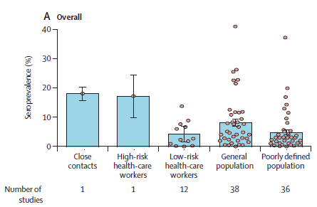
Global seroprevalence among HWs compared to general population
404 serological studies pooling serological surveys Dec 2019 – Dec 2020
  EURO 194 studies, Americas 120 and WPR 44
  representing tests in 5 168 360 individuals In the 82 studies of higher quality
Estimated ratio between confirmed cases and number of infections identified through serological surveys = 11.1 (95% CI 8.3–14.9)
Low-risk HWs who use PPE had lower seroprevalence (4.2%, 1.5–6.9) than the general population (8.0%, 6.8–9.2)
In high-risk HW (defined as no PPE usage), seroprevalence was higher than low-risk HWs
Chen X et. Al. Lancet GH, 2021.
Chen X et. Al. Lancet GH, 2021.
Notes:
Serological evidence of human infection with SARS-CoV-2: a systematic review and meta-analysis
HR HCW - A group of persons who provided routine medical care for virologically confirmed or suspected COVID-19 patients during the infectious period
without wearing personal protective equipment
LR HCW - A group of persons who provided routine medical care for virologically confirmed or suspected COVID-19 patients during the infectious period with the use of personal protective equipment, as well as those people who provided medical care for non-COVID-19 patients
The ratio suggesting that for each virologically confirmed SARS-CoV-2 infection, at least ten infections remained undetected by surveillance systems
This study was looking at both HCW and general population on a regional level without comparing the dates of the studies and sub-regions

Slide 10
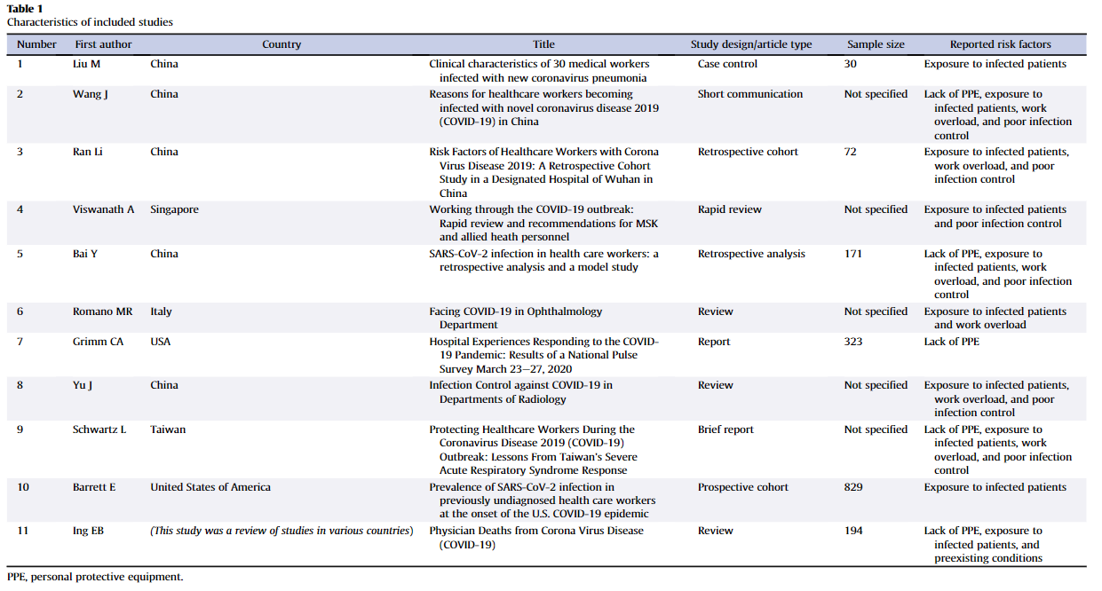
Risk factors – initial waves
Poor infection control
Lack/shortage of PPE
Unprotected exposure to infected patients
Work overload
Preexisting medical conditions

Slide 11
Risk factors of HW infections
Increased Risk
Decreased Risk
Certain exposures (e.g., involvement in intubations, more direct or intense, prolonged patient contact, or contact with bodily secretions)
Black & Asian HWs and of Hispanic ethnicity (USA & UK) associated with a statistically significant increased risk of infection compared to other groups
IPC training and education on risk of infection
Appropriate use of adequate PPE (limited evidence on specific PPE but most consistent for masks and observed for gloves, gowns, eye protection)
Hand hygiene
Universal masking
Presence of existing SARS-CoV-2 IgG antibodies – decreased risk of re-infection
No association found between age, sex, or HW role and risk of infection; infections were observed in various hospital departments.
Chou R, et al. Update alert 9: Epidemiology of and risk factors for coronavirus infection in health care workers. Ann Intern Med. 2021;174:W63-W4.
Notes:
Methodological limitations:
Wide variations of prevalence and incidence, likely related to differences in local epidemiology, rates of community transmission, exposures, use of IPC measures; PPE use, symptom status, clinical setting, and other factors.
Different criteria for screening HWs; potential recall bias; low or unclear participation rates; no controlling for confounders.
No study in the context of variants of concern

Slide 12
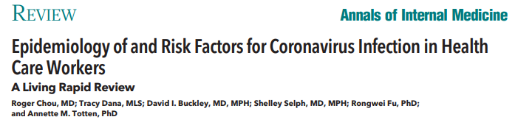
A living systematic review (August 2021 update): 255 studies included
Burden of infection in HW
Prevalence of SARS-CoV-2 seropositivity: 0.3% to 39.6%
Incidence: 0.4% to 49.6%
SARS-CoV-2 infection associated with better outcomes (hospitalization rate and mortality) in HCWs versus non-HCWs
No study performed genotyping to identify setting/source of exposure (community vs nosocomial)
Risk factors for infection in HW
No association between age, sex, and risk of SARS-CoV-2 infection. Occurrence in various H departments and HW role (nurse vs. physician), incl non-clinical roles
Increased risk of SARS-CoV-2 infection among HWs associated with:
  Black and Asian and Hispanic ethnicity relative to White race after adjustment for confounders (studies from USA & UK)
  Certain exposures (e.g. involvement in intubations, more direct or intense patient contact, or contact with bodily secretions)
Chou R, et al. Update alert 9: Epidemiology of and risk factors for coronavirus infection in health care workers. Ann Intern Med. 2021;174:W63-W4.
Notes:
Prevalence or incidence of SARS-CoV-2 seropositivity or infection ranged widely, likely related to differences in local epidemiology, exposures, PPE use, symptom status, clinical setting, and other factors.

Slide 13
A living systematic review (August 2021 update): 255 studies included
Decreased risk associated with:
  training in IPC and risk of infection
  adequacy and appropriate use of PPE (limited evidence on specific PPE but most consistent for masks but also observed for gloves, gowns, eye protection)
  hand hygiene
  presence of SARS-CoV-2 IgG antibodies associated with reduced risk of HCW (re)infection (limited evidence, 2 studies)
  universal masking was associated with decreased risk of HCW SARS-CoV-2 infection (5 studies)
Methodological limitations:
  Wide variations of prevalence and incidence, likely related to differences in local epidemiology, rates of community transmission, exposures, use of IPC measures; PPE use, symptom status, clinical setting, and other factors.
  Different criteria for screening HWs; potential recall bias; low or unclear participation rates; no controlling for confounders.
  No study in the context of variants of concern
Chou R, et al. Update alert 9: Epidemiology of and risk factors for coronavirus infection in health care workers. Ann Intern Med. 2021;174:W63-W4.
Notes:
Prevalence or incidence of SARS-CoV-2 seropositivity or infection ranged widely, likely related to differences in local epidemiology, exposures, PPE use, symptom status, clinical setting, and other factors.

Slide 14
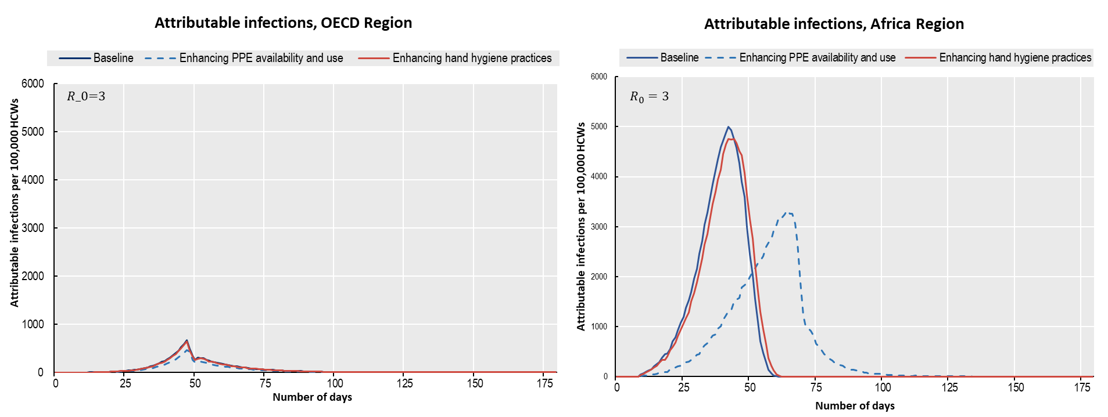

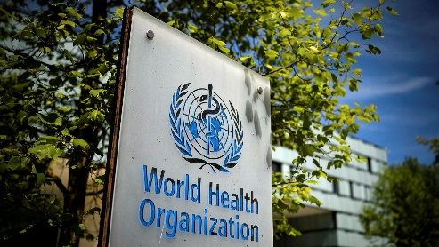
WHO-OECD joint study on health and economic impact of COVID-19 among health workers
Modelled the impact of improving IPC interventions in healthcare during outbreak response (hand hygiene; PPE; training)
At baseline, HW COVID-19 infections are 14 times higher and hospitalisations 3 times higher in African region than in OECD region
Main driver is higher availability of PPE: enhancing PPE would have avoided 70% HW infections in the African region during the first 50 days
Courtesy of Michele Cecchini and Ece Özçelik, OECD

Slide 15

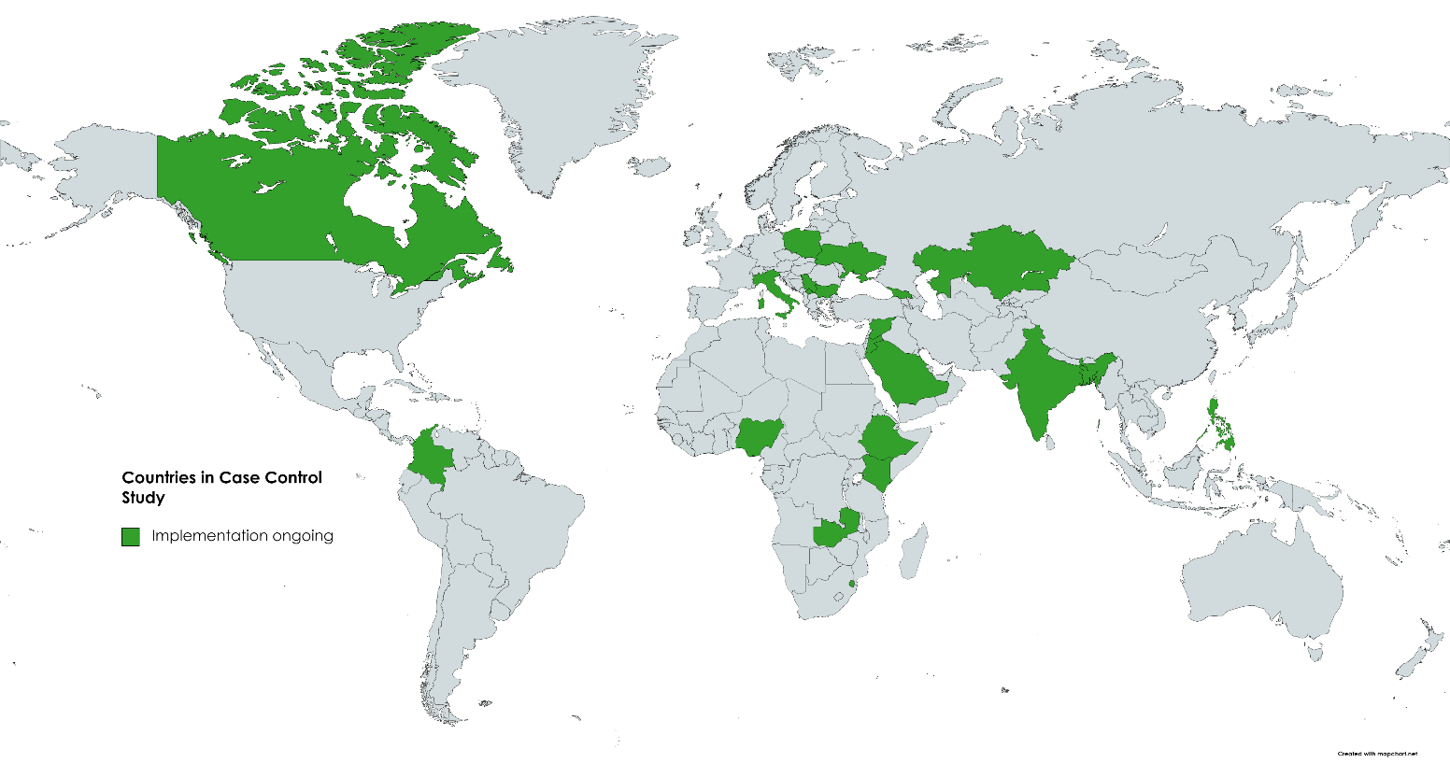

Global multicentre case control study on IPC risk factors
Results from the interim analysis suggests contact with body fluid and inappropriate masking during high-risk procedures may be associated with SARS-CoV-2 infection
Participating Countries and Sites
21 countries with over 56 health facilities
4,054 health workers enrolled to date
Currently clean analysable data from:
  1011 cases
  1041 controls
3 models of matched multi-variate regression analysis

Slide 16
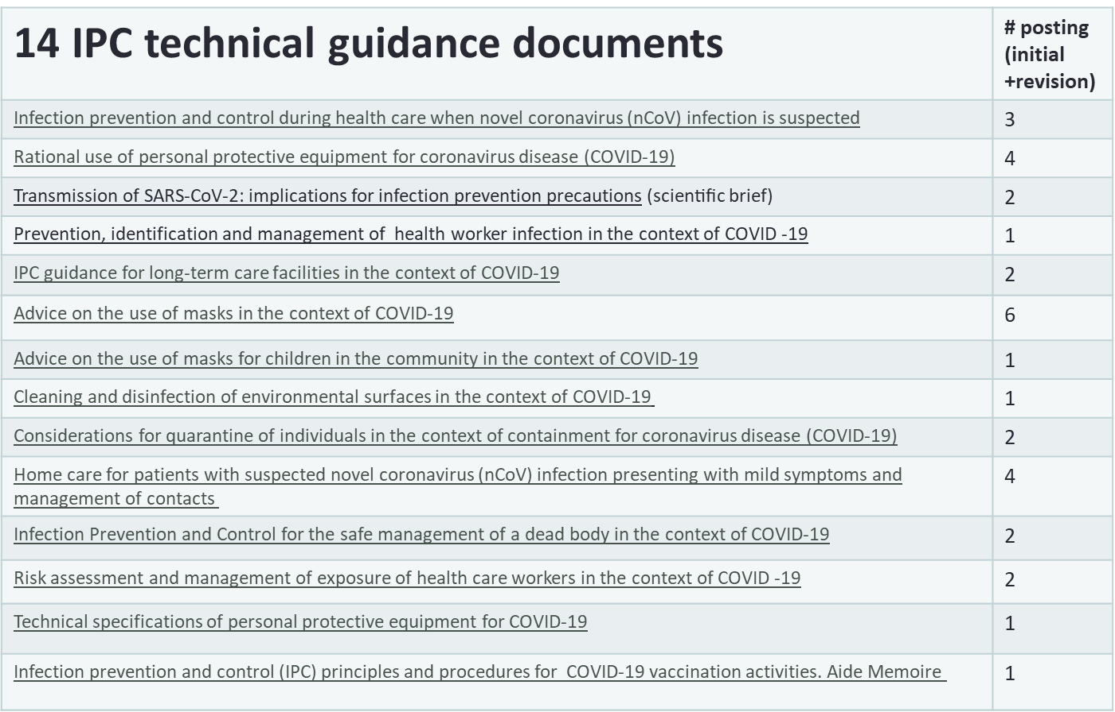
https://www.who.int/emergencies/diseases/novel-coronavirus-2019/technical-guidance
https://www.ecdc.europa.eu/en/publications-data/infection-prevention-and-control-and-preparedness-covid-19-healthcare-settings
https://www.cdc.gov/coronavirus/2019-ncov/hcp/infection-control.html

Slide 17
Barriers
Lengthy and ambiguous local guidelines or not reflecting national or international guidelines
Local guidelines were constantly changing
IPC strategies led to increased workloads and fatigue
Lack of training / not mandatory
Lack of / insufficient PPE, poor quality PPE
Masks and other equipment uncomfortable to use or creating barriers for patients
Facilitators
Level of support felt received from their management team / safety climate/culture
Clear communication
Training how to use PPE
Sufficient space to isolate patients
Minimising overcrowding, fast-tracking infected patients, restricting visitors, and providing easy access to HH facilities

Slide 18
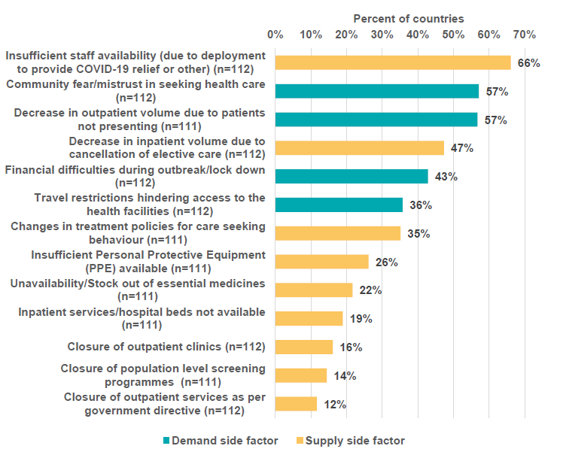
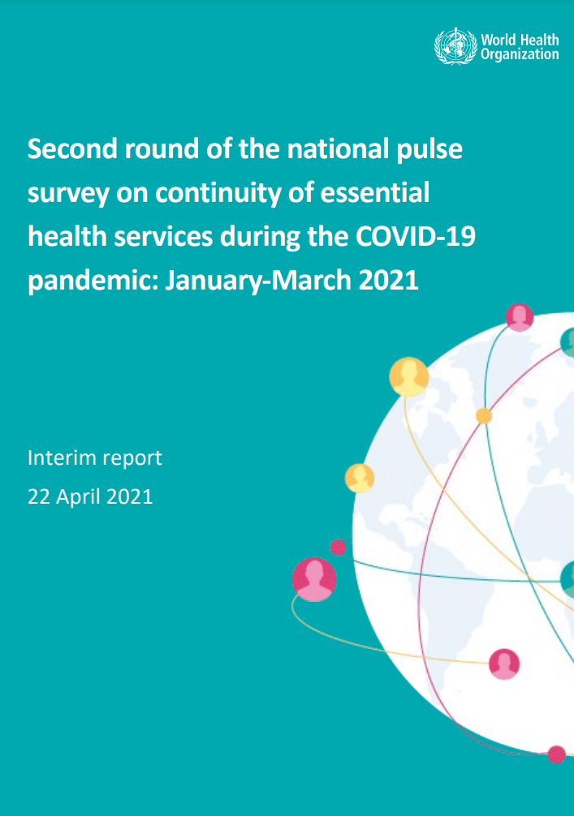
Essential health service disruptions: Human resource challenges
Notes:
The figure above shows the mix of demand and supply side factors responsible for disruption to services.
On the supply side, the following causes were most frequently reported:
➢ insufficient staff availability, for example due to deployment of staff to COVID-19 or other causes (66% of 112 countries);
➢ cancellation of elective care (47% of 112 countries);
➢ changes in treatment policies for care-seeking behaviours (35% of 111 countries); and
➢ insufficient personal protective equipment availability (26% of 111 countries).
Demand-side factors were among the most mentioned causes, including:
➢ Community fear and mistrust in seeking health care (57% of 112 countries);
➢ patients not presenting to outpatient care (57% of 111 countries);
➢ perceptions that financial difficulties during the outbreak were affecting attendance (43% of 112 countries
https://www.who.int/publications/i/item/WHO-2019-nCoV-EHS-continuity-survey-2021.1

Slide 19
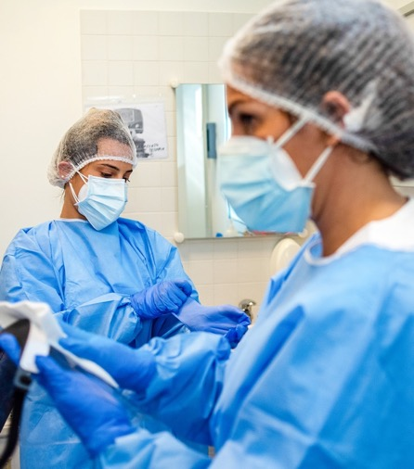
Other occupational risks in health workers
Apart from a high risk of COVID-19 infection, other occupational risks in health workers need to be considered.
Work time and workload
Harassment, violence, stigma and discrimination
Mental health

Slide 20
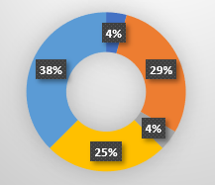
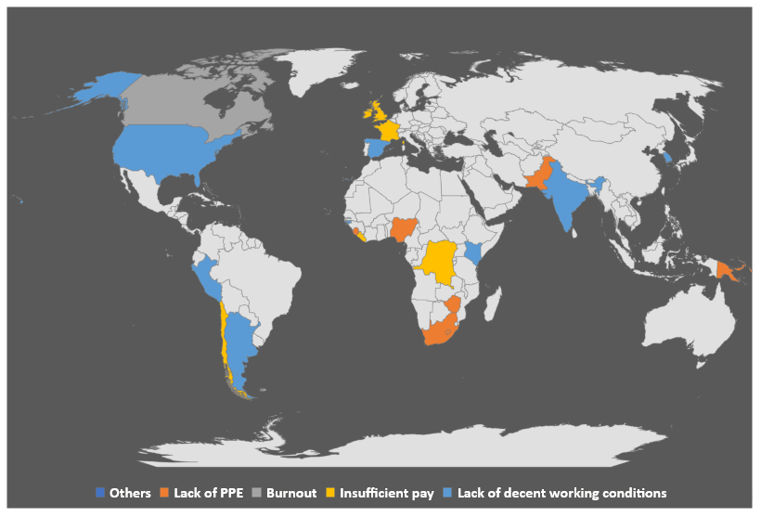
Increasing labour disputes reveal widespread dissatisfaction
COVID-19 context
↑ Health services disruption
↑ Health worker infections and deaths
% reasons for health worker strikes
Need: Active engagement between health worker organizations and management
Notes:
Health worker strikes and industrial disputes have been recorded in at least 84 countries around the world since the onset of the COVID-19 pandemic. Independently, a rapid review further attributed contributory factors in 23 countries + 1 special administrative region, based on media documentation. The legend at the bottom left reflects the primary cause.
38% of the labour disputes were due to a lack of decent working conditions. (https://accountabilityresearch.org/publication/health-worker-protest-project/)
A separate review of health professionals found a 23% prevalence of depression and anxiety, and 39% prevalence of insomnia during the COVID-19 pandemic. (https://www.ncbi.nlm.nih.gov/pmc/articles/PMC7206431/)

Slide 21
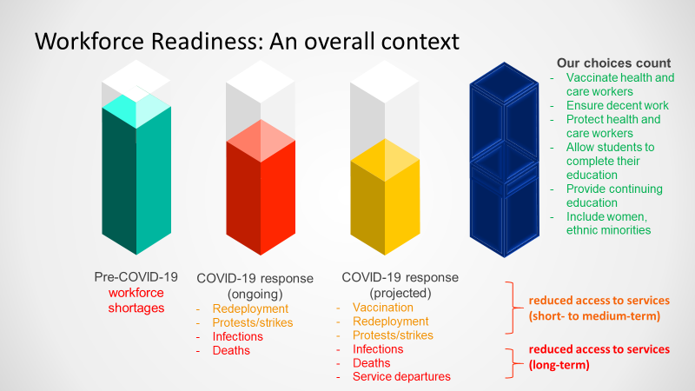
Notes:
*The represented proportions are not to scale. In fact, the notional proportions also do not represent increasing health demands resulting from both COVID-19 long- and short-term impacts, as well as catch-up services.
Acknowledging the significant service delivery deficits and maldistribution in many contexts, one must first visualise a glass half full… and imagine each reallocation as a straw, drying out the existing resources.
These dynamic changes can impact health workforce availability, readiness and sustainability, as several COVID-19 response activities require surge capacity (among which are clinical care, contact tracing and now vaccination). COVID-19 response activities and investments may be negatively affected by pre-pandemic deficits and misdistribution of health workers.

Slide 22
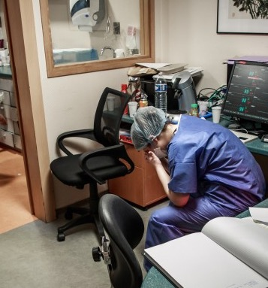
Organizing work time and workload for a healthy and safe work environment
During the response to the pandemic, health workers may be working long hours with heavy workloads and insufficient time for rest and recuperation
This can result in chronic fatigue and lack of energy, with decreased alertness, coordination and efficiency; increased reaction time; impaired cognition and mood changes
To prevent chronic fatigue in health workers:
Provide enough available staff
Ensure the allocation of the workload is fair
Ensure longer working hours are only temporary
WHO: Health workforce policy and management in the context of the COVID-19 pandemic response; ILO: Guidelines on decent work in public emergency services

Slide 23
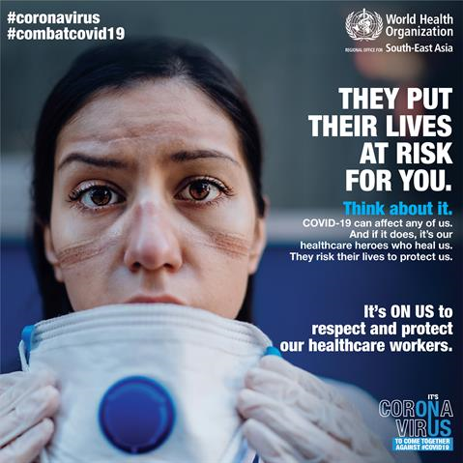
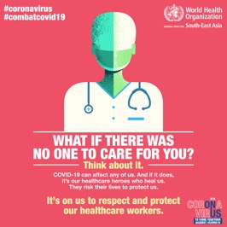
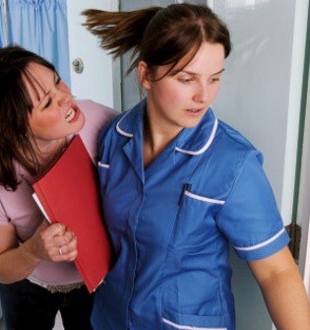
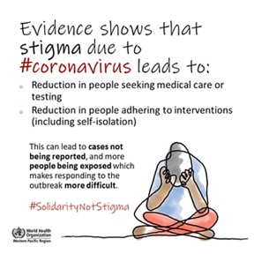
Prevent violence, harassment, stigma and discrimination of health workers
Increasing incidents of harassment, stigma and discrimination have been reported during the pandemic
Policies for prevention include:
Regulations that criminalize violence and harassment against health workers
Policies for prevention of workplace violence in the health sector
Policies for reporting of incidents and for security measures
Communication around behavioural standards and community-engagement projects to prevent stigmatization of health workers
Promoting respect for health workers
Photo: Jim Varney/Science Photo Library
23

Slide 24
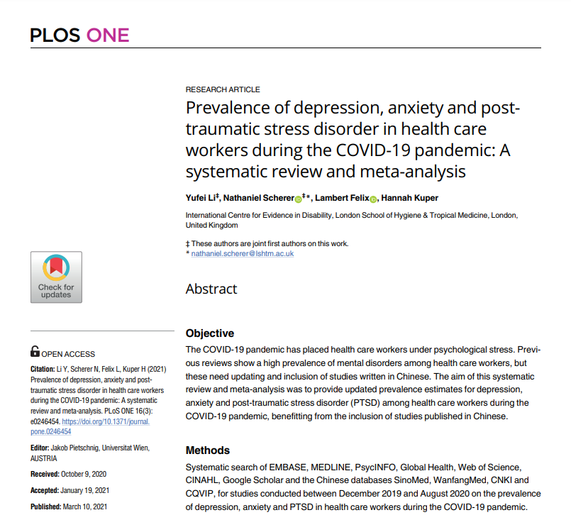
Li. 2021. Prevalence of depression, anxiety and post-traumatic stress disorder in health care workers during the COVID-19 pandemic: A systematic review and meta-analysis
65 studies, 97,333 health care workers, 21 countries, 70% female
Cross sectional
Anxiety pooled prevalence: 23.2% (95% CI 17.8-29.1, I² = 99%)
Depression pooled prevalence: 22.8% (95% CI 15.1-31.51, I²=99·6%)
Insomnia pooled prevalence 34.3% (95% CI 27.5–41.5, I² =98%)

Slide 25

Mental health and psychosocial support for health workers
OpenAccess Government
Ensure that accurate information updates are provided to all health workers
Rotate workers from higher-stress to lower-stress functions
Partner inexperienced workers with experienced colleagues
Ensure access to confidential mental health and psychosocial support services for health workers
Train health leads in basic psychosocial skills
Provide mechanisms for early and confidential identification and management of anxiety, depression and other mental health conditions, and initiate first-line interventions
  Promote a mental health prevention culture among health workers and health managers
  Ensure health workers who develop mental health conditions and seek help can return to their work without stigma or discrimination

Slide 26
Dimension | Evidence
Stigma and discrimination | HCW were at increased risk to experience stigma and bullying adjusted OR: 1.5 (95% CI 1.2 to 2.0) (1).
Violence | Since the beginning of the outbreak, attacks on health care have continuously been reported and now also include incidents linked to the COVID-19 pandemic across the world. (2)
Lack of PPE | Lack of PPE for HCWs was observed in several countries(3,4).
Strike actions | An independent analysis has identified industrial dispute and strike action in 84 Member States since February 2020; of which 38% and 29% of strikes are due to poor working conditions and lack of PPE, respectively. (5)
Quarantine and self- isolation | In a survey of health professionals and allied employees, 24% of HCWs declared that they had to return to work while still having symptoms of COVID-19. (6)
Other working conditions | Role of privatization in delivery of services, managerial practices in nursing homes exacerbated impact of COVID-19. (7) HCWs experienced difficulties in receiving compensation after getting infected with COVID-19. (8)
Repurposing, surge capacity | It has been reported that in some circumstances HCWs were expected to continue working even after a positive COVID-19 test due to staff shortages. (9)
^{[1]} Dye TD, Alcantara L, Siddiqi S, et al. BMJ Open 2020;10:e046620. doi: 10.1136/bmjopen-2020-046620
^{[2]} https://www.who.int/news-room/feature-stories/detail/attacks-on-health-care-in-the-context-of-covid-19
^{[3]} J Cohena, YM Rodgersc. Contributing factors to personal protective equipment shortages during the COVID-19 pandemic. Prev Med. 2020 Dec; 141: 106263.
^{[4]} https://www.who.int/news/item/03-03-2020-shortage-of-personal-protective-equipment-endangering-health-workers-worldwide, https://www.afro.who.int/news/protecting-health-workers-covid-19
^{[5]} https://www.who.int/campaigns/annual-theme/year-of-health-and-care-workers-2021/facts
^{[6]} Health professionals and allied employees. Exposed and at risk. HPAE white paper July 2020.
^{[7]} Pat Armstrong, et al.. Privatization and COVID-19: A Deadly Combination for Nursing Homes July 2020 In book: Vulnerable: The Policy, Law and Ethics of COVID-19. Publisher: University of Ottawa Press
^{[8]} https://www.govtech.com/em/safety/Hospital-Workers-Getting-Coronavirus-on-the-job-as-Hospitals-Push-Back.html
^{[9]} https://www.nbcnews.com/news/us-news/north-dakota-lets-healthcare-workers-covid-stay-job-record-surge-n1247487, https://www.healthcaredive.com/news/hospital-workforce-tracker-layoffs-furloughs-and-pay-cuts/576890/, https://www.beckershospitalreview.com/workforce/record-number-of-healthcare-workers-laid-off-furloughed-during-pandemic.html

Slide 27
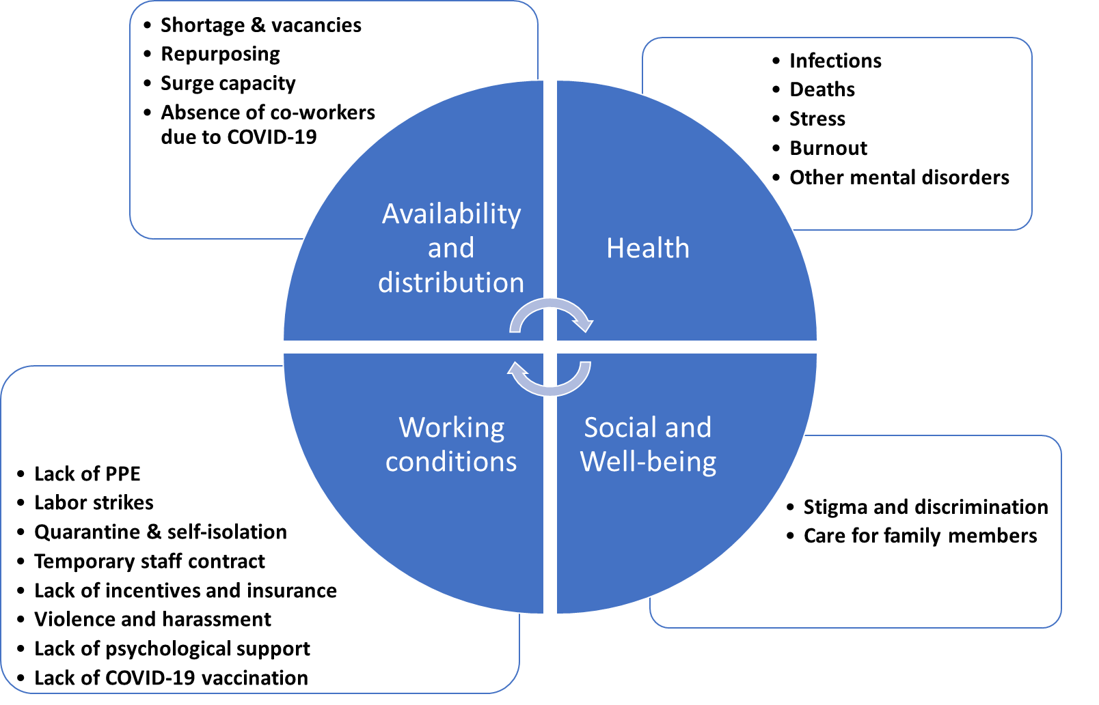
WHO weekly epidemiological update 30 March 2021
68% of service disruptions due to staff redeployment / inavailability
26% due to insufficient PPE (1)
4M+ health and care worker infections (3)
Among health workers
23% prevalence of depression & anxiety
39% prevalence of insomnia (4)
84 recorded labour strikes
38% due to lack of decent working conditions (2)
Increased risk of stigma & bullying (5)
Violence & attacks reported
Need: holistic approach to monitor the impact of COVID-19 on health and care workers
Notes:
Prior to COVID-19, many countries faced health workforce shortfalls and maldistribution
In every context, the available pool of health workers to deliver essential health services is shrinking through:
Redeployment to COVID-19: low- to high-COVID-19 burden areas, surge support to ICU, reassignment/upskilling for specific skills, telemedicine
Facility closures and temporary halts in essential services delivery, in some cases with layoffs
Strikes for decent working conditions, PPE shortages, reasonable working hours, fair remuneration
Infection, quarantine, death

Slide 28
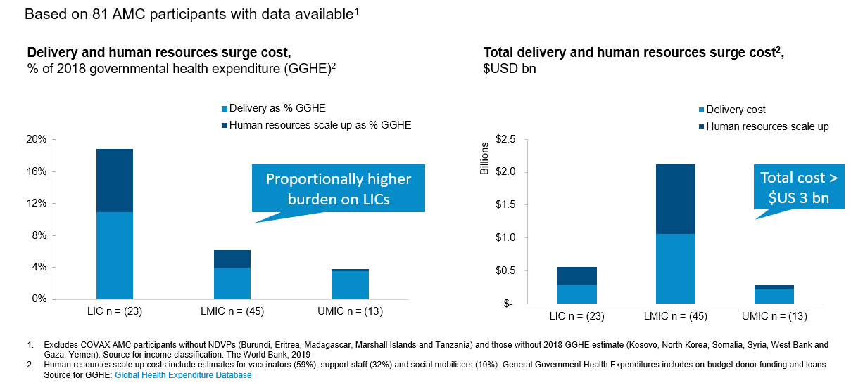
Investment need: Delivery and HWF additional salary (% of GGHE and in USD)
Costing tool for countries: CVIC jointly developed by UNICEF and WHO
Graph from UNICEF and WHO

Slide 29
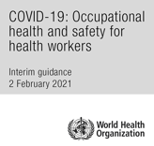
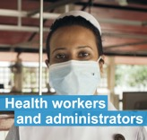
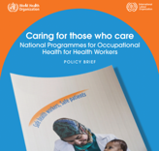
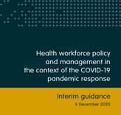
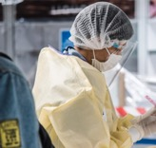
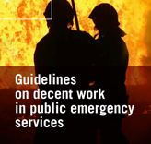

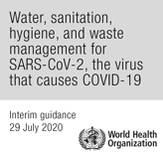
Resources
COVID-19: Occupational health & safety for health workers
This interim guide provides specific measures to protect occupational health and safety of health workers and highlights the duties, rights and responsibilities for health and safety at work.
Health workers and administrators
Health workers face higher risks of infection and are exposed to hazards such as psychological distress, fatigue and stigma. Here, WHO provides the latest advice & guidance for health workers and administrators.
Caring for those who care
A short overview on the issues and recommendations for policy decision-makers in ministries of health and ministries of employment and labour.
Health workforce policy and management
An interim guidance on health workforce policy and management in the context of the COVID-19 pandemic response.
OpenWHO: Occupational health & safety for health workers in the context of COVID-19
All health workers require knowledge and skills to protect themselves and others from the occupational risks they encounter, so that they can work safely and effectively.
Guidelines on decent work in public emergency services
Guidelines on decent work taken in response to crisis situations arising from conflicts and disasters. Governments are encouraged to provide PES workers with adequate means, tools and resources to be able to respond effectively to emergencies.
OpenWHO: COVID-19 vaccination training for health workers
All health workers involved in implementation of COVID-19 vaccination need to have adequate knowledge and skills in order to ensure safe and efficient COVID-19 vaccine administration.
Water, sanitation, hygiene, and waste management for SARS-CoV-2
The provision of safe water, sanitation, waste management and hygienic conditions is essential for protecting human health during COVID-19.

Slide 30
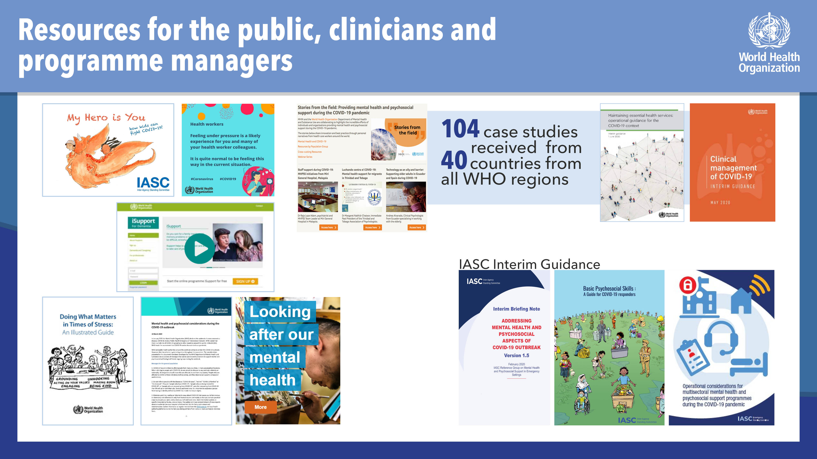

Slide 31
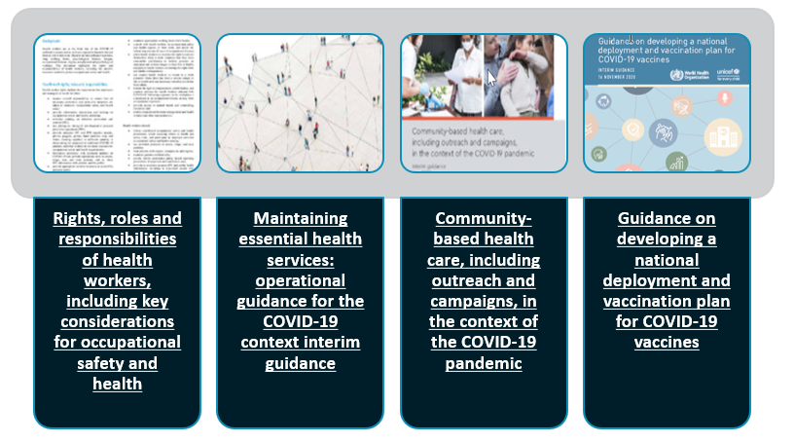
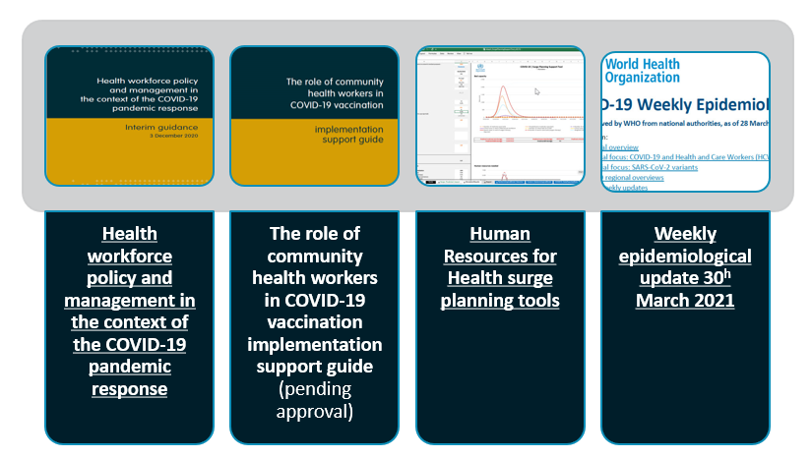



Resource: guidance, tools, learning
Cross-cutting guidance & tools++
Extensive WHO cross-departmental collaboration: emergencies, health systems, occupational health & safety, immunization, communicable diseases, risk communication…
Engagement with regions, ACT-A, UN partners, CSOs, gender advocates, health professional associations, academia
Protect. Invest. Together.
HRH guidance and tools
Education & learning
Guidance & tools
Collaboration on reporting of standardised data
*WHO Academy COVID-19 app
*Engagement with GOARN as early app adopter; technical webinar presentation
*TEPHINET collaboration on classification and reporting of epidemiologists & public health workers
Notes:
1. In every context, health workers must be ready, in adequate quantities, with the right education and learning, with evidence-based guidance and with the necessary resources to protect themselves, patients and communities
2. Despite the demands of the global pandemic, wise decisions required to safely maintain essential health services and avoid cascading impacts of health service outages.
3. This requires adaptations to
service delivery: telemedicine, adopting safety protocols, tightening scheduling, modifying clinical approaches and
team composition: within COVID-19 response teams; more significant engagement of community-based workers, optimising roles, engagement of retirees and students
Policy & regulation

Slide 32








Health workforce lessons learned in COVID-19
Ensure adequate quantities and type of health workers.
Guarantee decent working conditions
Equip health workers with additional required skills and competencies
Enact rapid mobilization and re-deployment policies and mechanisms
Protect from infection (refresh/monitor IPC practices and ensure adequate PPE)
International solidarity to allow HRH investments
Agile work with partners to gather data, synthesize learning, innovate
Optimize roles
Notes:
Health and care workers are central to surge response and vaccine rollout…
We must protect human resources for health so they endure beyond the pandemic
We must invest in their learning, decent work and increasing their numbers
Together, we must prioritise action based on science, evidence and solidarity

Slide 33
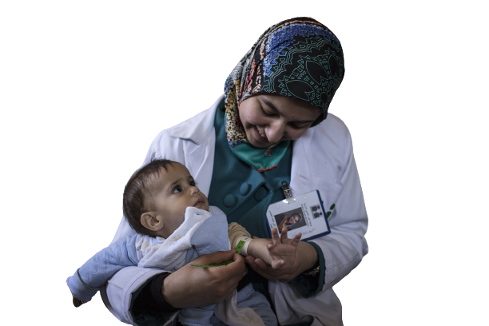
2021: International Year of Health and Care Workers
Protect. Invest. Together.
Ensure the world’s health and care workers are prioritised for the COVID-19 vaccines
in the first 100 days of 2021
Recognize and commemorate all health and care workers who have lost their lives
during the pandemic.
Mobilize commitments from Member States, International Financing Institutions, bilateral and philanthropic partners to protect and invest in health and care workers to accelerate the attainment of the SDGs and COVID-19 recovery
Engage Member States and all relevant stakeholders in dialogue on a care compact to protect health and care workers’ rights, decent work and practice environments.
Bring together communities, influencers, political and social support in solidarity, advocacy and care for health and care workers.
Notes:
The designation by the 73rd World Health Assembly of 2021 as the International Year of Health and Care Workers represents an unprecedented window of opportunity to not only recognize their contribution and commemorate lives lost during the pandemic, but also to mobilize commitments to accelerate the attainment of the SDGs and COVID-19 recovery.
COVID-19 has highlighted the centrality of protecting health workers from infection, ensuring their occupational health and safety, and upholding their rights to decent working conditions.
An integrated approach to health and social care workforce planning has to consider workforce requirements holistically, be data-driven and translate requirements into policy and investment decisions that can address population and health system needs, including by ensuring safe staffing of health facilities.
New opportunities lie in harnessing the potential of digital health innovations for both education and delivery of services, and of adopting more flexible strategies to optimize roles and scope of practice, including through integration of health and social care services.
Realizing this ambitious change agenda requires bringing together different sectors in government (including health, education, finance, labour) and constituencies in society, including communities, influencers, political and social support in solidarity, advocacy and care for health and care workers.

Slide 34
Thank you
cassinia@who.int

Slide 35
Prevention of COVID-19 in health workers should be involve risk assessment
Risk level | Health worker tasks & roles | Preventive measures for workers
Low risk | Jobs or tasks without frequent, close contact with the public and that do not require contact with people known or suspected of being infected with SARS-CoV-2. (For example: telehealth workers, remote interviewing of suspected or confirmed COVID-19 patients or their contacts | Use fabric masks in common areas and face-to-face meetings
Medium risk | Jobs or tasks with close frequent contact with patients, visitors, suppliers and co-workers but that do not require contact with people known or suspected of being infected with SARS-CoV-2 | Wear medical masks and other PPE and apply standard precautions in providing patient care
High risk | Jobs or tasks with high potential for close contact with people who are known to be or suspected of being infected with SARS-CoV-2 or contact with objects and surfaces possibly contaminated with the virus | Use PPE (medical mask, gown, gloves, eye protection) and apply standard precautions in providing patient care
Very high risk | Jobs and tasks with risk of exposure to aerosols containing SARS-CoV-2, in settings where aerosol-generating procedures are regularly performed on patients with COVID-19 or working with infected people in indoor, crowded places without adequate ventilation | Use PPE (respirator N95 or FFP2 or FFP3, gown, gloves, eye protection, apron) and apply standard precautions in providing patient care
Determine the level of risk for occupational exposure related to different jobs, work tasks and work settings
Plan and implement adequate measures for risk prevention and mitigation
Assess fitness for work and return to work, of individual health workers; such as those with pre-existing medical conditions
The risk of occupational exposure increases with the level of SARS-CoV-2 transmission in the community
COVID-19: Occupational health and safety for health workers (who.int)

Slide 36
Number of deaths due to Covid-19 reported, and estimated according to different sources (Jan 2020-May 2021)
X 2-4 times
higher than
reported data
Notes:
Attributing deaths by occupation introduces an additional level of uncertainty. The WHO COVID-19 Surveillance data requested countries to focus on the disaggregation of infections and deaths among HCWs. In the earliest months of the pandemic (March-May 2020), reports from Member States showed that HCWs experienced more than triple the risk of infection as that of the general population.
In general, 40% of COVID-19 deaths are unregistered

Slide 37
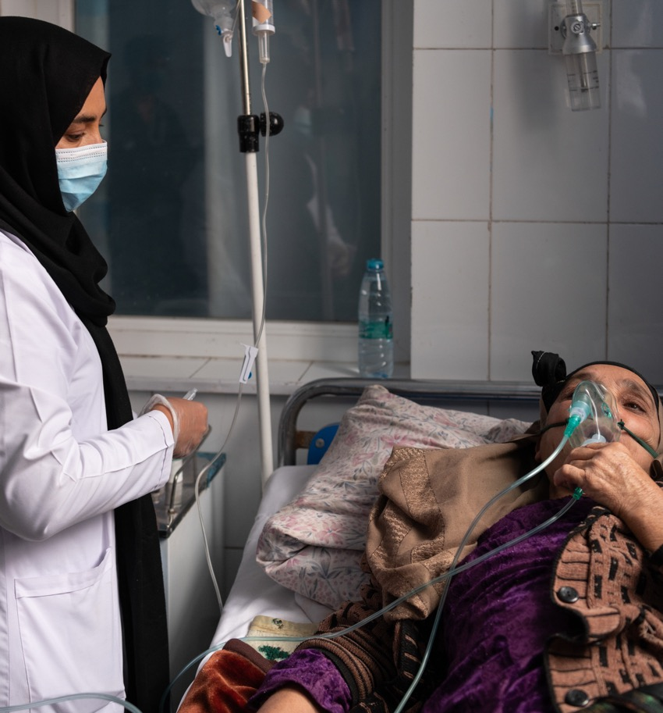
Health workers are at increased risk of SARS-CoV-2 infection
Health workers account for around 7.7% of COVID-19 cases reported to WHO, but great variability (WHO global surveillance)
Health and care workers can be infected with SARS-CoV-2 while at work or at the community level
Those caring for COVID-19 patients are considered at a higher risk of being infected

Slide 38
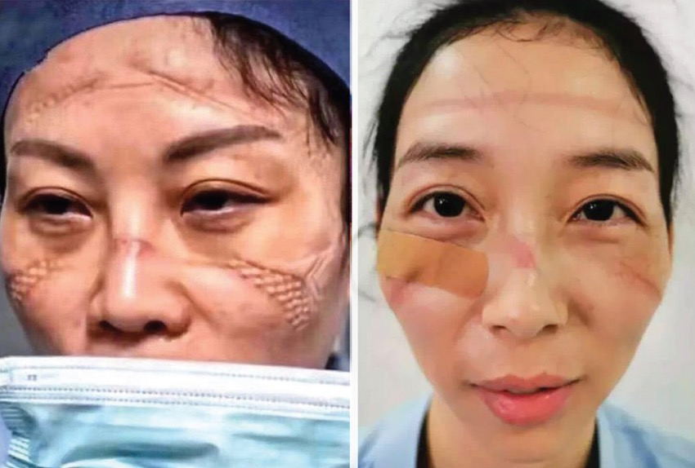
Prevent prolonged use of PPE
PPE is intended to be used for short periods of time
In the context of COVID-19, heavy workload, patient flows and shortages of PPE may require health workers to wear PPE for extended periods of time
If used for a long period of time, PPE can cause eczema, contact dermatitis, skin lesions or heat stress
Advice for health workers on safe use of PPE
Use non-latex or nitrile gloves in case of latex allergy
Use properly fitted PPE
Apply moisturizers or gel before wearing gloves and facial protective equipment
Avoid using over-tight goggles, which can damage the skin and generate fogging
Limit the time spent in full PPE
Rest in a cool area
Drink enough safe drinking-water
Avoid using coveralls, double layering of gowns, shoe protection or hoods
Medical Device-Related Pressure Injury in health care professionals in times of pandemic

Slide 39
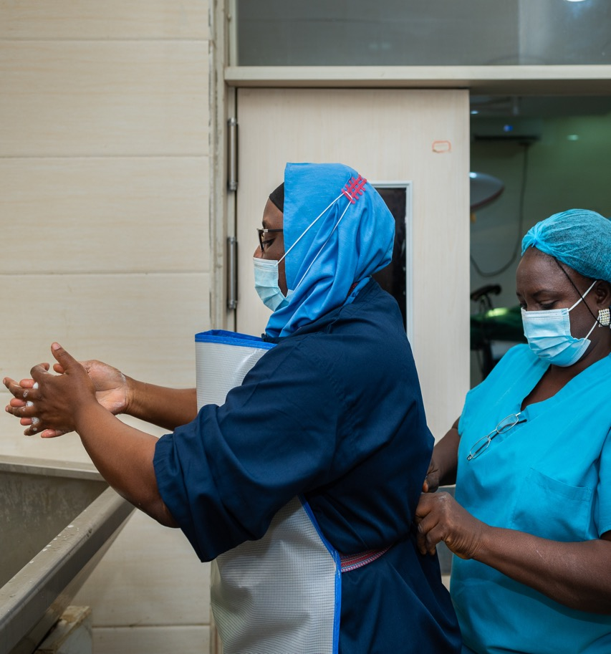
Ensure adequate sanitation, hygiene and rest facilities for health workers
Provide hand hygiene facilities
Provide rest rooms, safe drinking-water, toilets and supplies for personal and menstrual hygiene
Provide space for personal and menstrual hygiene
Ensure daily cleaning and cleaning protocols
Provide facilities for changing clothes and professional laundry for work clothes
Train health workers in the safe use of disinfectants and provide adequate PPE
Do not spray individuals with disinfectants (such as in a tunnel, cabinet or chamber) under any circumstances

Slide 40
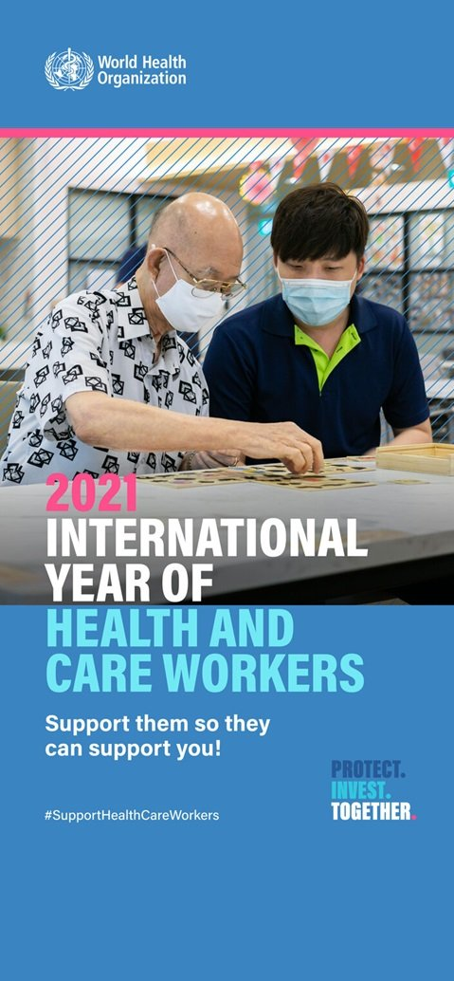
2021
International Year
of
Health and Care Workers
#Protect. #Invest. #Together
Campaign objective No 1:
Ensure the world’s health and care workers are prioritised for the COVID-19 vaccine in the first 100 days of 2021. (#VaccineEquity campaign)

Slide 41
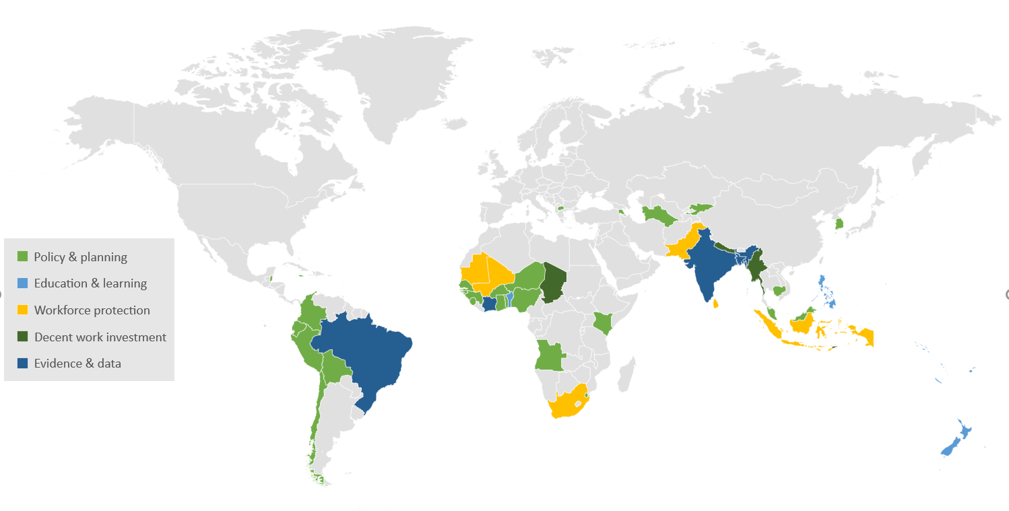
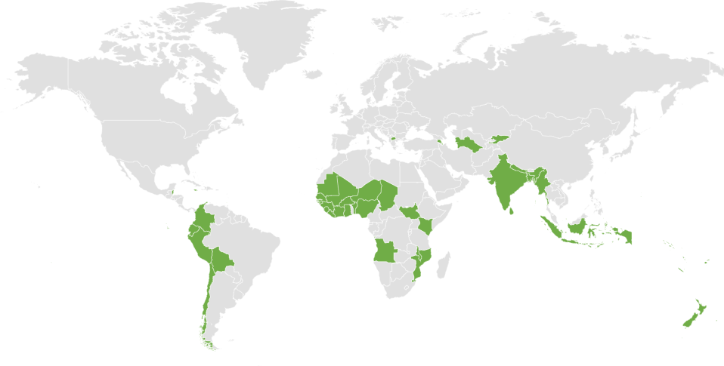
HWF technical support
Protect. Invest. Together.
Technical support in 58 countries
(as of March 2021, incomplete reporting)
Case studies in 28 countries
Assess COVID-19 impact on the health workforce
Analyze countries’ responses,
Draw key lessons to inform policy makers
With regional offices, respond to country requests for technical support

